Slide 1
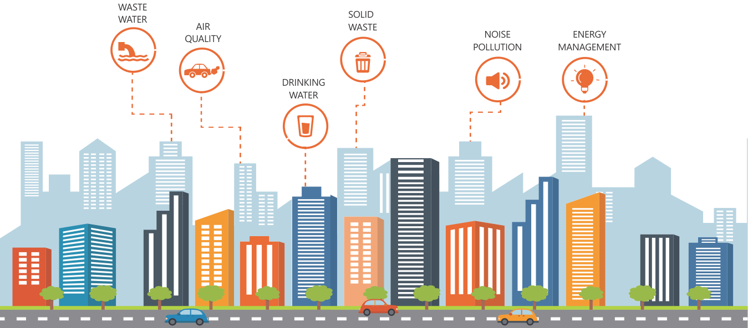
INTERNET OF THINGS FOR ENVIRONMENTAL MANAGEMENT OF SMART CITY
By:
Akshay N Mahajanshetti (001893697)
Arshdeep Randhawa (001841490)
Arjit Kiledar (001846796)

Slide 2
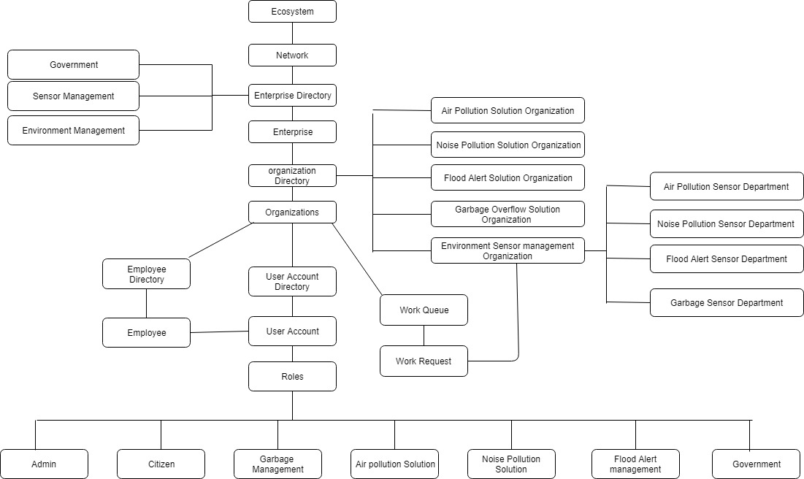
OBJECT DIAGRAM

Slide 3




PROBLEM OVERVIEW
Environmental pollution has existed for centuries but started to be more significant in recent times. There are environmental crisis in almost all the cities of the world. Pollution must be taken seriously, as it has a negative effect on natural elements that are an absolute need for life to exist on earth, such as water and air. So we need better ways to manage it and inform the citizens and the concerned environment officials about the crisis at the earliest, so that it can be managed before the situation gets out of hand

Slide 4
OPPORTUNITY
Considering the Problem statement, Sensors could be brought in use to look into the exceeding pollution levels in Environment.
Sensors can turn out to be very effective to detect the threshold level of the harmful elements present in Air, the increase in decibel level in noise, increase in waste in garbage bins and increase in water level for flood alerts.
Since the sensors can communicate with each other, we need to take advantage of that and automate the manual process.
Sensors could be used to convey the detected pollution in environment to sensor board and unique feature of work request in Ecosytem model can be used to improve the condition of environment.

Slide 5
SOLUTION
The purpose of this project is to help in the environment management by tracking the Air Quality Index, Flood Alert Level, Increase Noise decibels and waste in garbage with the help of sensors.
Air Quality index (AQI) will be sensed by the sensor placed in open air and reading of all the sensor will be available with sensor management department and as soon as they get AQI above than threshold they will send it solution department for solution.
Similarly for case of flood Alert, sensors will be placed in rivers and reading will be taken. If the reading is increased above the threshold than concerning solution department will be notified by work request.
In case of Noise pollution the sensors placed in specific zipcode will take the reading of noise in the environment and report it to sensor management department which will check for areas above certain threshold of decibels in noise and further report it to solution department.
For Garbage pollution,Sensors will be placed in the bins and when the level goes above threshold value, the concerned solution department will be notified to clear the bins.

Slide 6
APPLICATION KEY FUNCTIONALITIES
In our Application model, we are using IOT technology to send work requests to the concerned environmental officials from the sensors.Simultaneously ,we are also sending notifications to the citizens about certain scenarios.We are primarily taking 4 factors into consideration which are as follows :
1.GARBAGE MANAGEMENT IN A CITY
2.AIR POLLUTION MANAGEMENT IN A CITY
3.FLOOD AND RIVER POLLUTION MANAGEMENT IN A CITY
4.NOISE POLLUTION MANAGEMENT IN A CITY

Slide 7
KEY ROLES
Sensor management role – This department will note the readings of the sensors and will notify solution department and government in case of increase air pollution or flood alert.
Solution management role – This role will be different for every specific type of pollution reading like Air pollution solution department, flood Alert solution department, noise pollution solution department .
Government role – This is the role which is included for air pollution or flood alert. If there is warning of air pollution or flood then a request will be send to government to notify the citizens about the on going environmental condition.
Citizen role – This is the role which will receive the request as to which area is under environmental problem like flood or air pollution.

Slide 8
Special Features
Total Ecosystem model for the project.
Use of Bar graphs and Line graphs to show the areas with high risk of air, flood and noise pollution.
Using real time maps to detect the area affected with pollution.

Slide 9
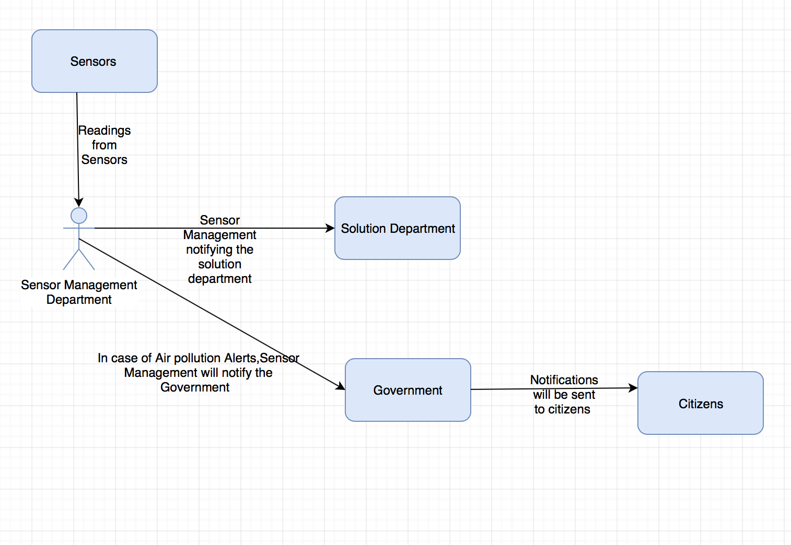
Sensor Management Department View

Slide 10
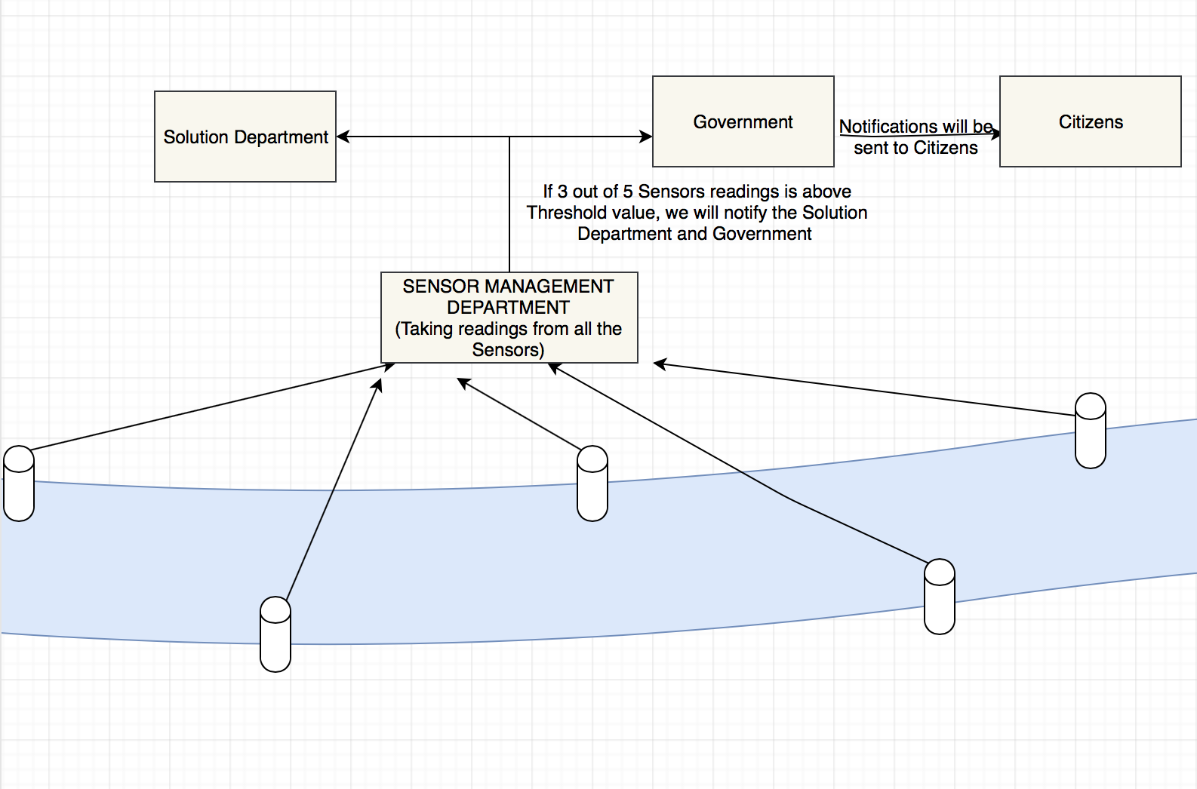
FLOOD ALERT MANAGEMENT ARCHITECTURE VIEW

Slide 11
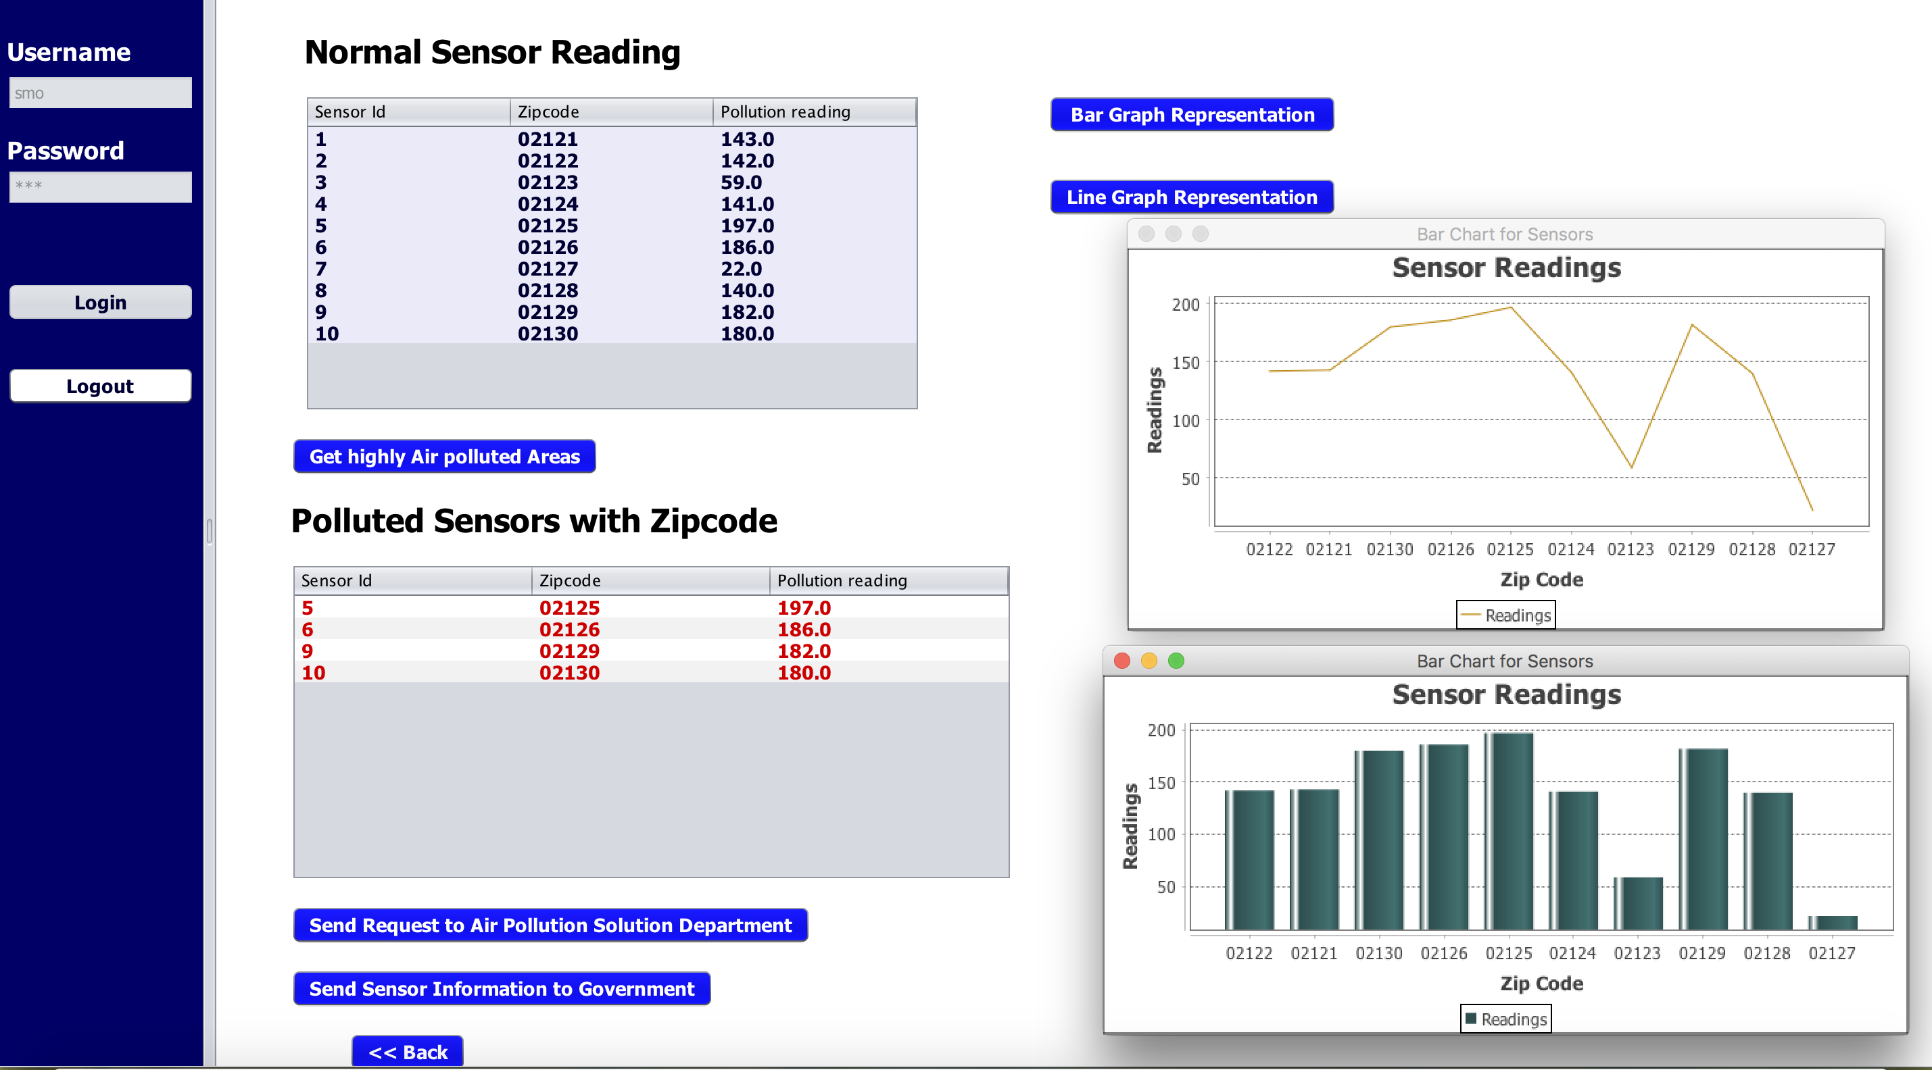
Air Pollution Management Work Area
The table below Normal Sensor Reading gives the reading of all the sensors of various locations relevant to their zip codes.
The table below Polluted Sensors with Zipcode gives the readings of those zip codes which are above the threshold value.
Bar graph and line graph representation shows the Sensor readings of all areas with respect to their zip codes.

Slide 12
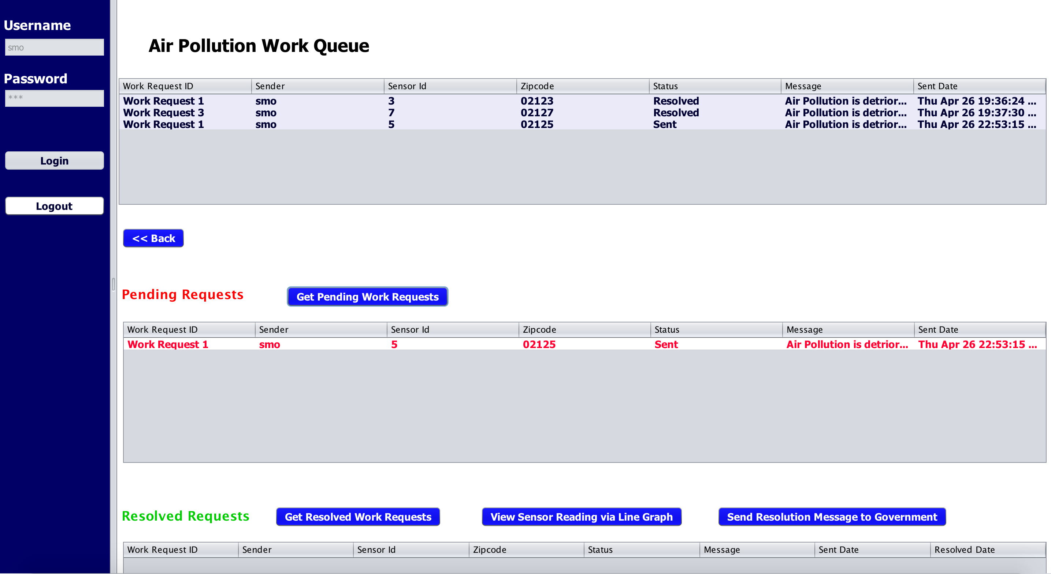
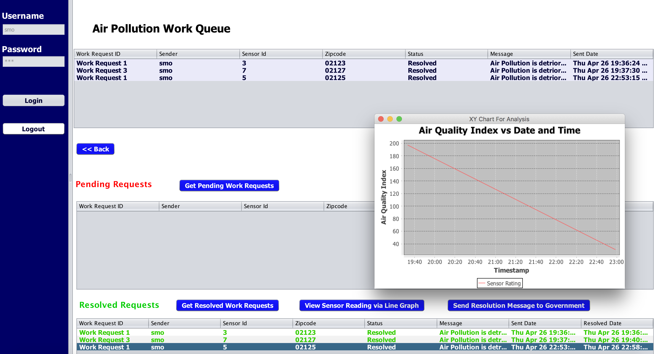
Air Pollution Solution Department
This represent the Air Pollution work queue of Sensor Management organization.
First table shows all the work requests created and resolved.
When we click on “Get Pending Work Request”,pending work request gets displayed in the “Pending Request” table.
Once the request is resolved, on clicking “Get resolved work request”,resolved request gets displayed in the “Resolved Request” table.
On clicking “View Sensor Reading”,we can see the reading of that particular sensor going below Threshold value by line graph.

Slide 13
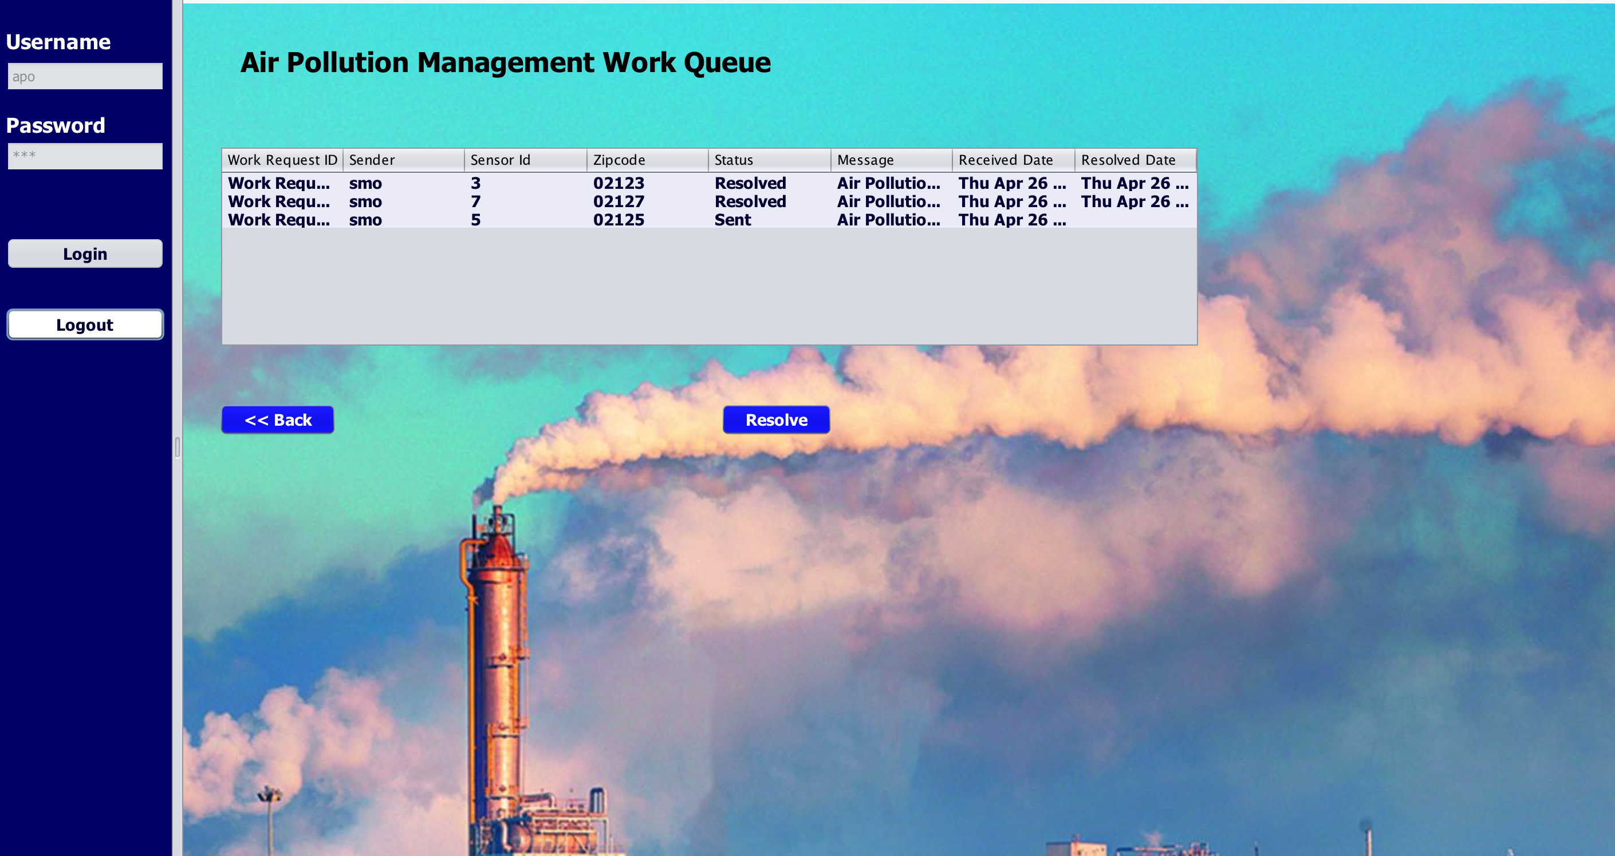
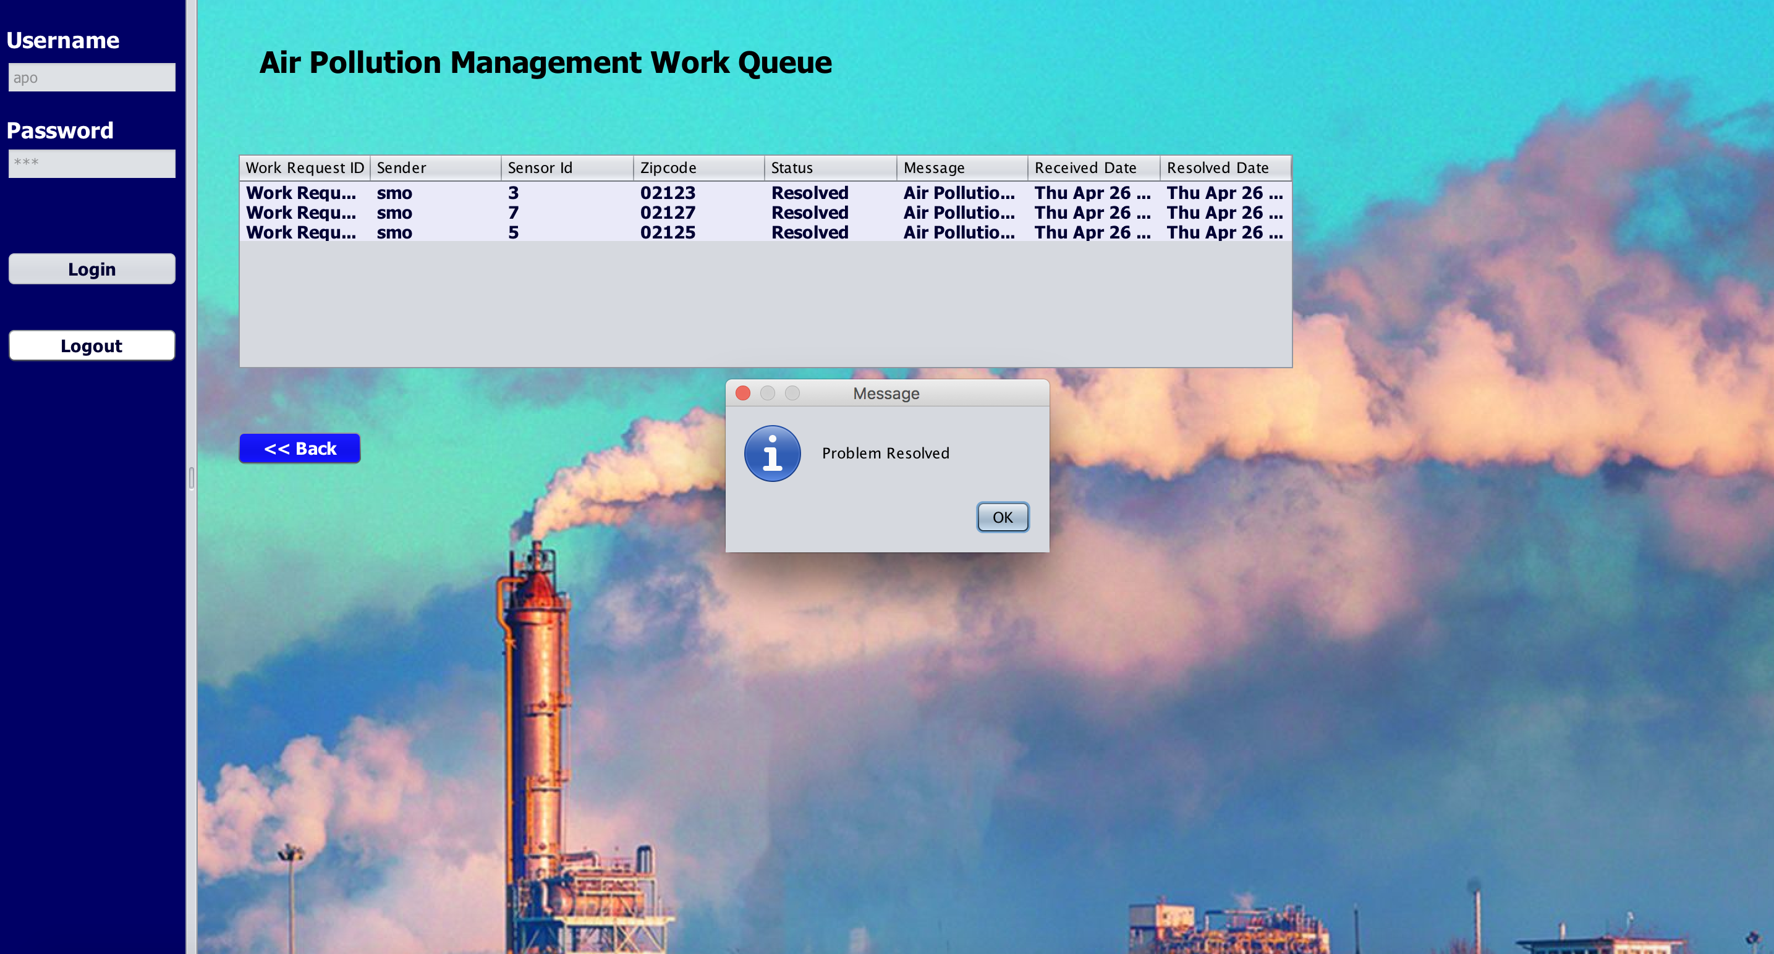
Air Pollution Management Work Queue
This screen shows that the Status is set to “Sent”, when the request is received from Sensor Management Department.
When the Solution Department press “Resolve” button, then the Status will be changed to “Resolve”.

Slide 14
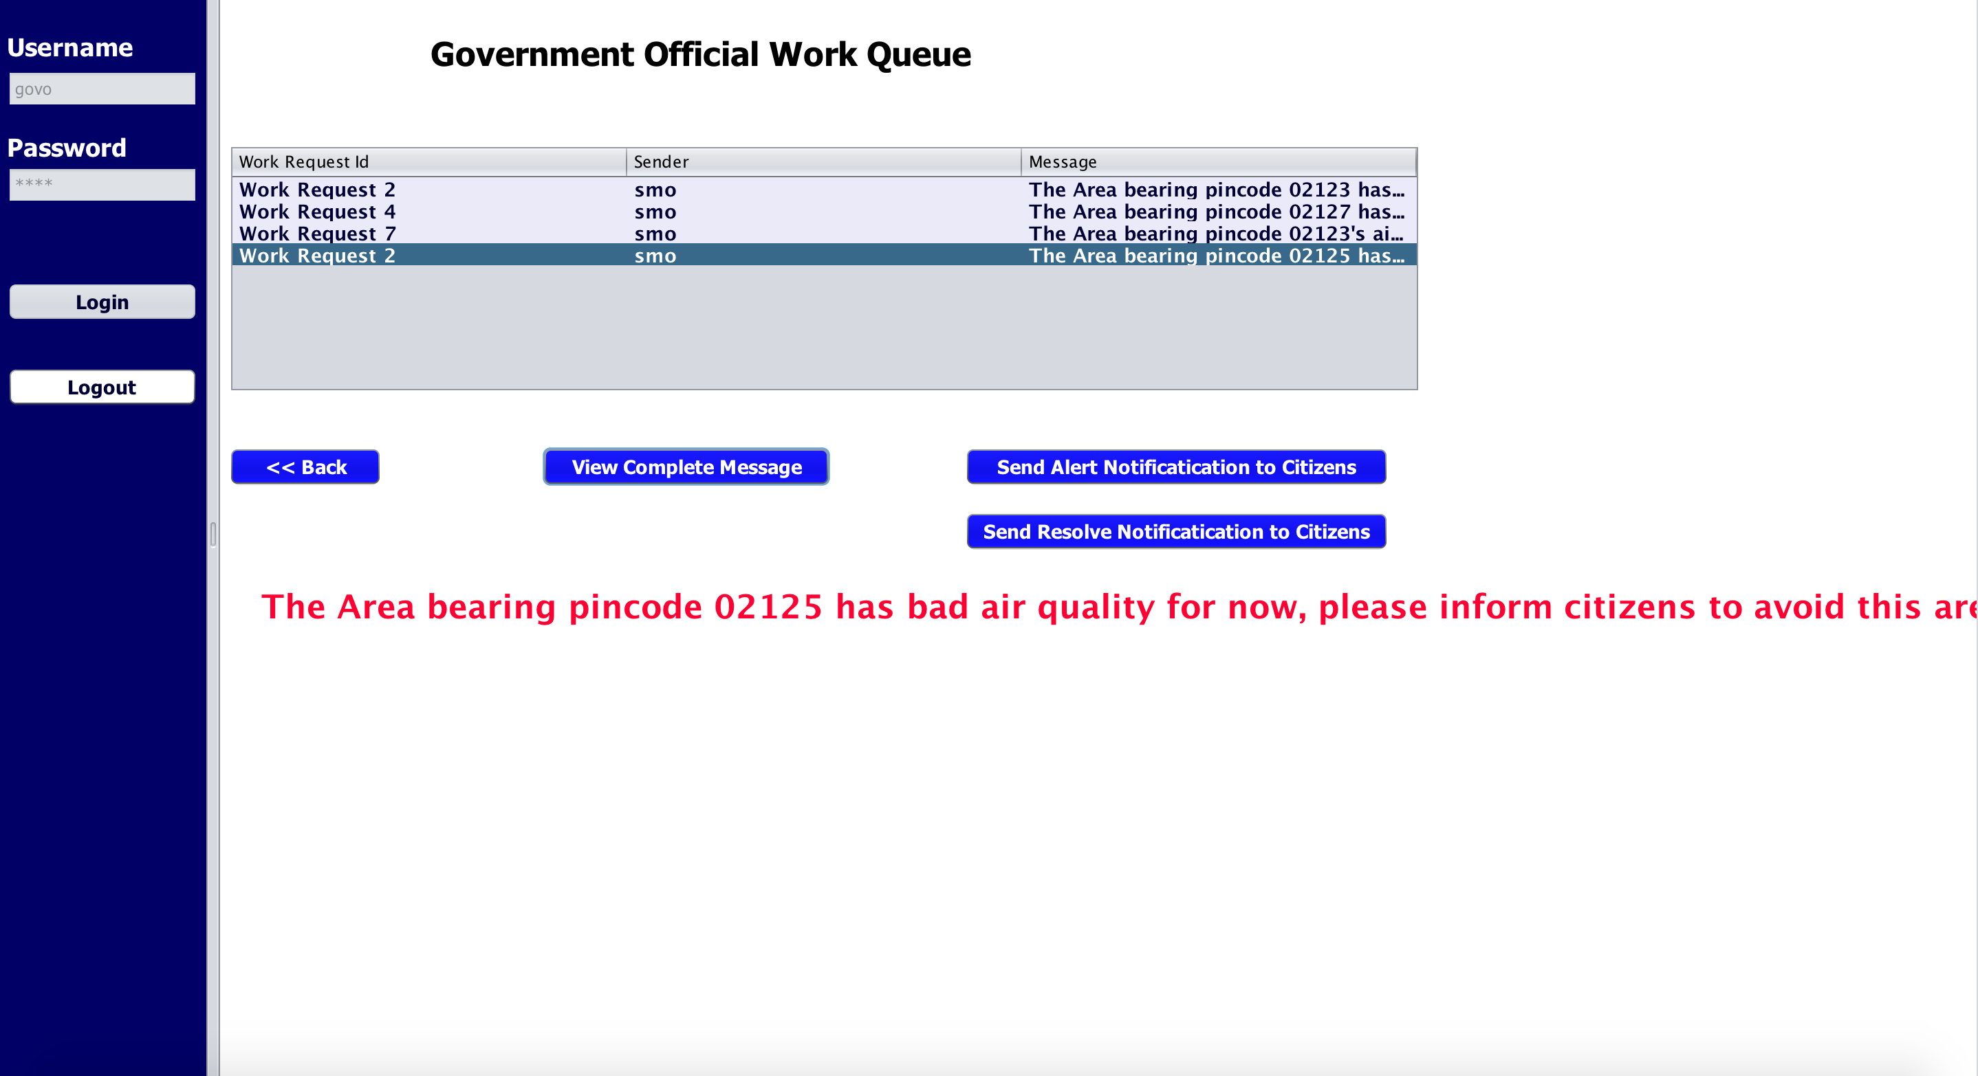
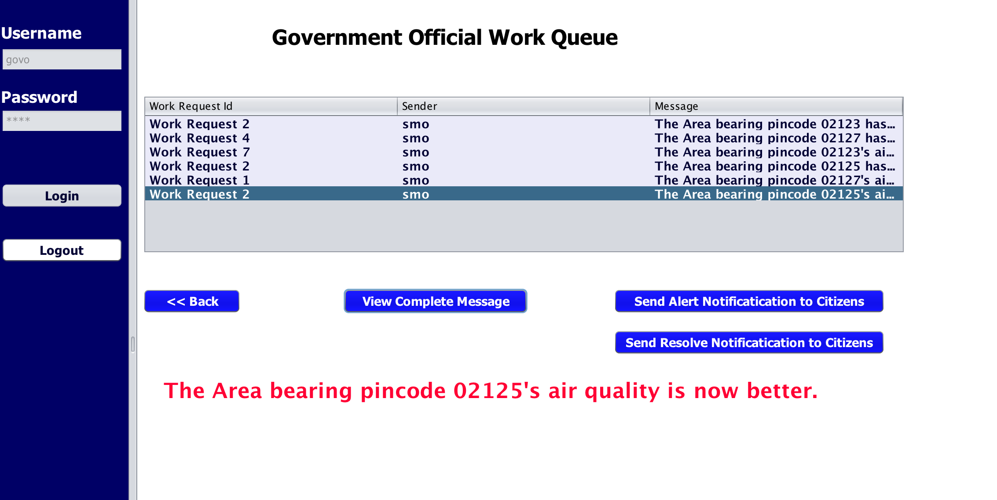
Government Work Queue
Sensor Management Organization will notify government about the bad air quality of that area to inform citizens.
Once the request is resolved, Sensor Management Organization will notify government so that they can tell the citizens.

Slide 15
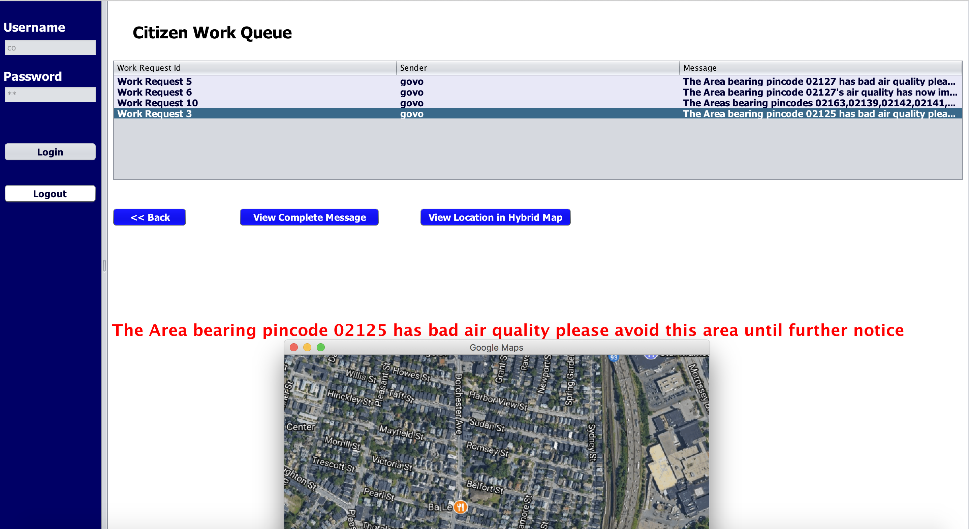
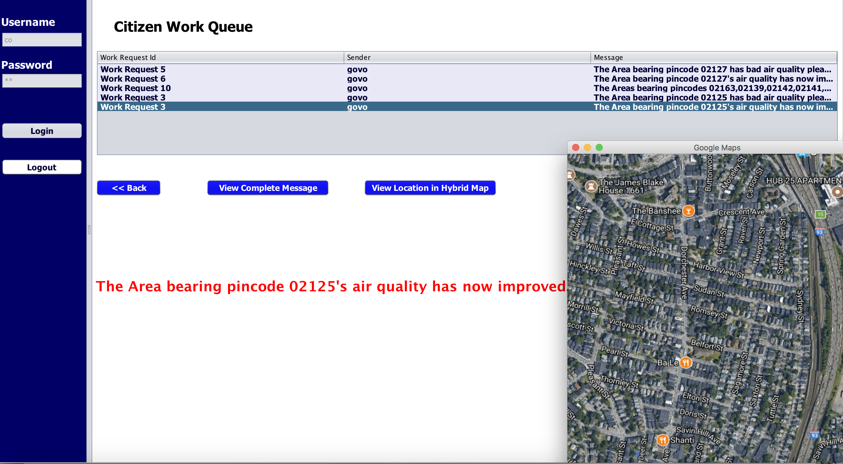
Citizen Work Queue
Government will notify citizens about bad air quality
Once the air quality is improved, citizens will be notified by Government

Slide 16
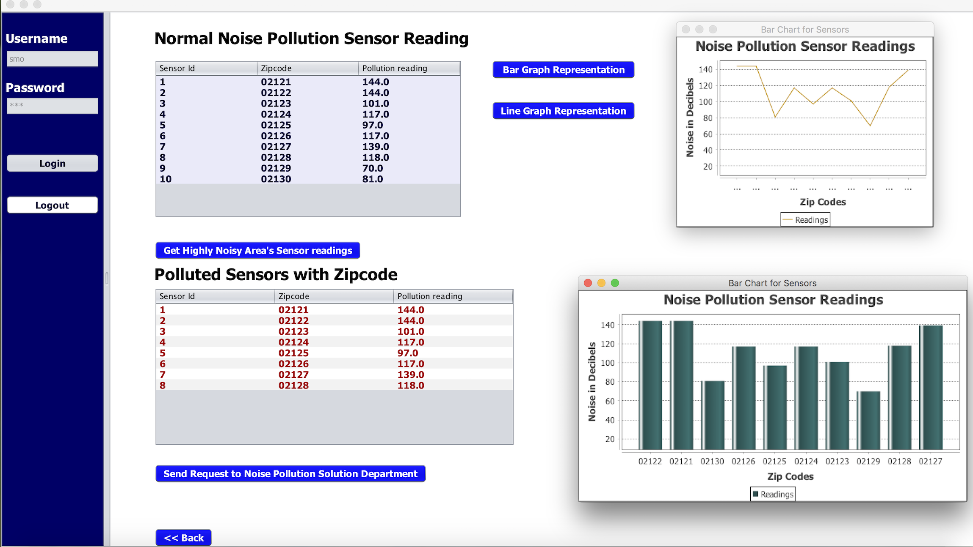
NOISE POLLUTION MANAGEMENT WORK AREA
The table below Normal Noise Pollution Sensor Reading gives the reading of all the sensors of various locations relevant to their zip codes.
The table below Polluted Sensors with Zipcode gives the readings of those zip codes which are above the threshold value.
Bar graph and line graph representation shows the Sensor readings of all areas with respect to their zip codes.

Slide 17
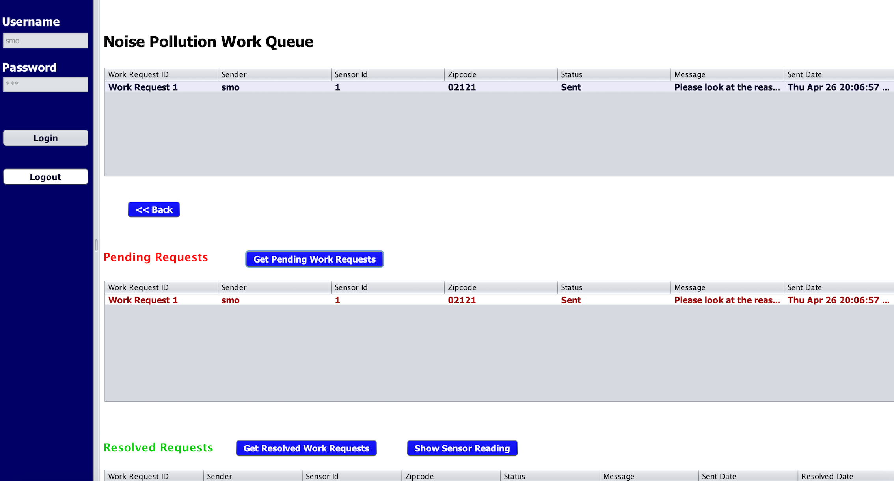
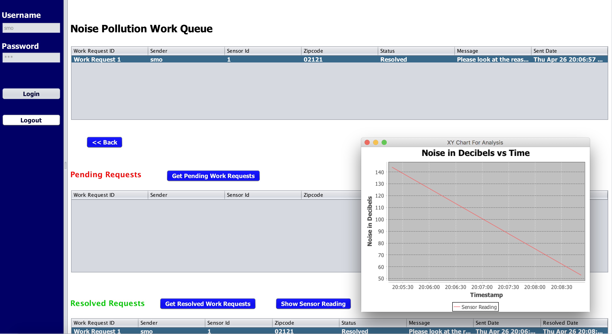
Noise Pollution Solution Department
This represent the Air Pollution work queue of Sensor Management organization.
First table shows all the work requests created and resolved.
When we click on “Get Pending Work Request”,pending work request gets displayed in the “Pending Request” table.
Once the request is resolved, on clicking “Get resolved work request”,resolved request gets displayed in the “Resolved Request” table.
On clicking “Show Sensor Reading”,we can see the reading of that particular sensor going below Threshold value by line graph.

Slide 18
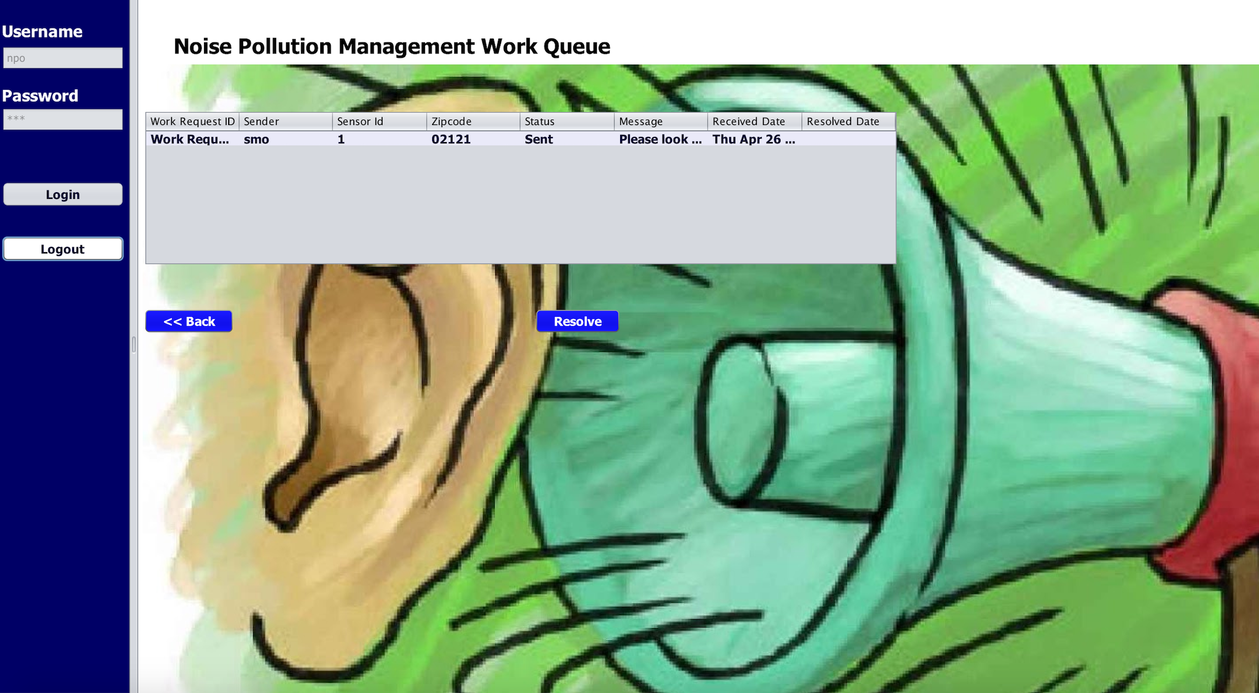
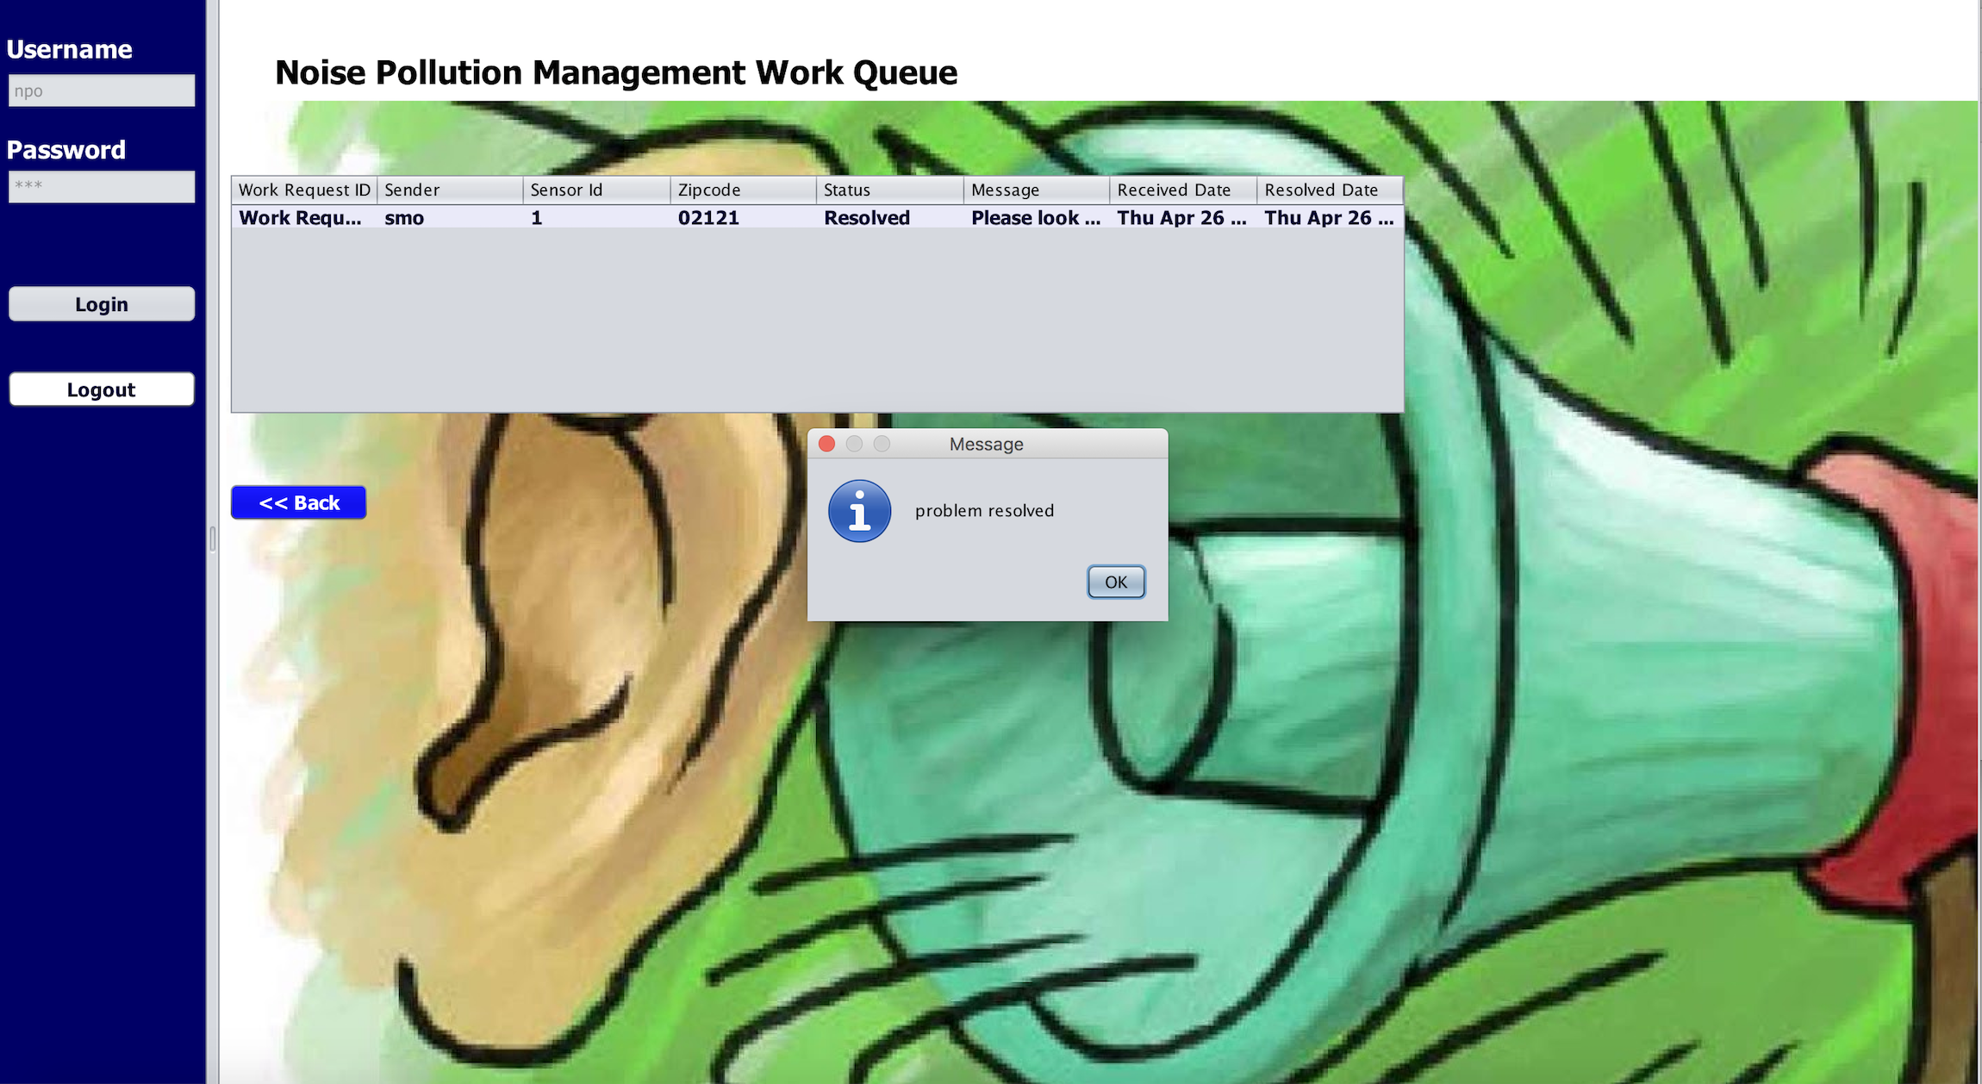
Noise Pollution Management Work Queue
This screen shows that the Status is set to “Sent”,when the request is received from Sensor Management Department.
When the Solution Department press “Resolve” button, then the Status will be changed to “Resolve”.

Slide 19
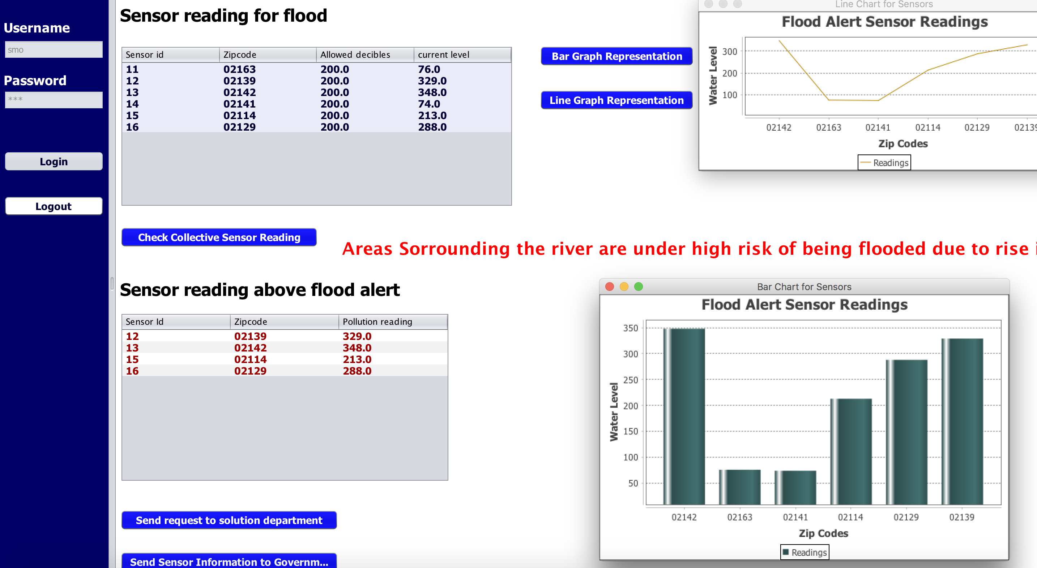
FLOOD POLLUTION MANAGEMENT WORK AREA
The table below Sensor Reading for flood gives the reading of all the sensors of various locations relevant to their zip codes.
Once we click on collective sensor reading icon, sensor reading above flood alert table will be populated.If the collective value is above threshold, then a message will be displayed saying “Areas surrounding river are under high risk”.
Bar graph and line graph representation shows the Sensor readings of all areas with respect to their zip codes.

Slide 20
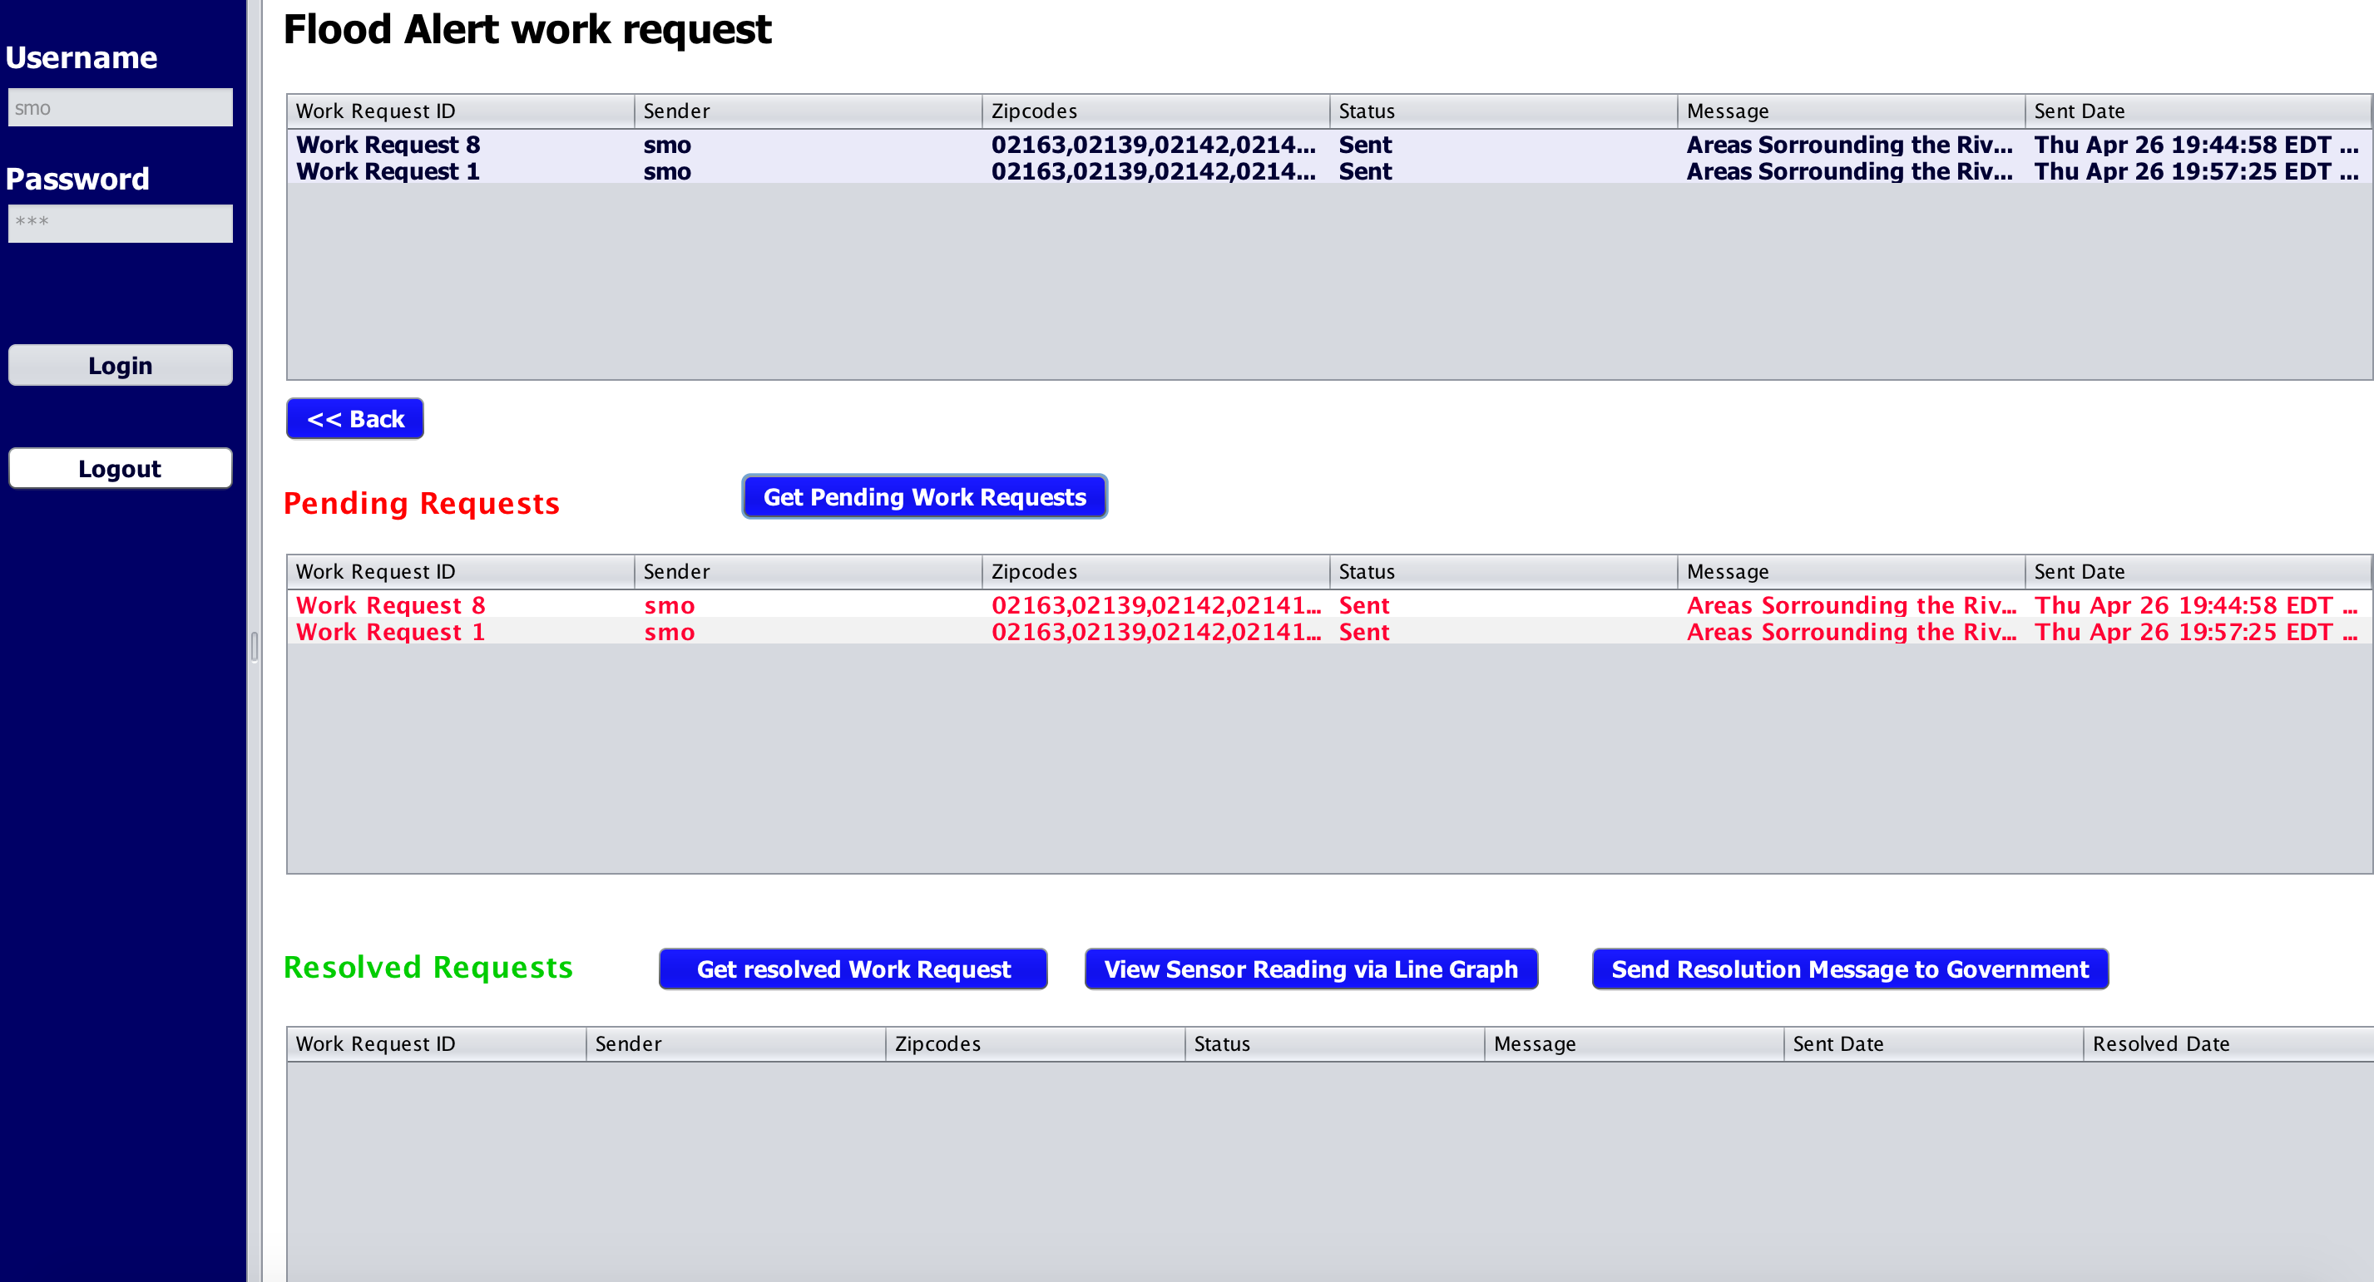
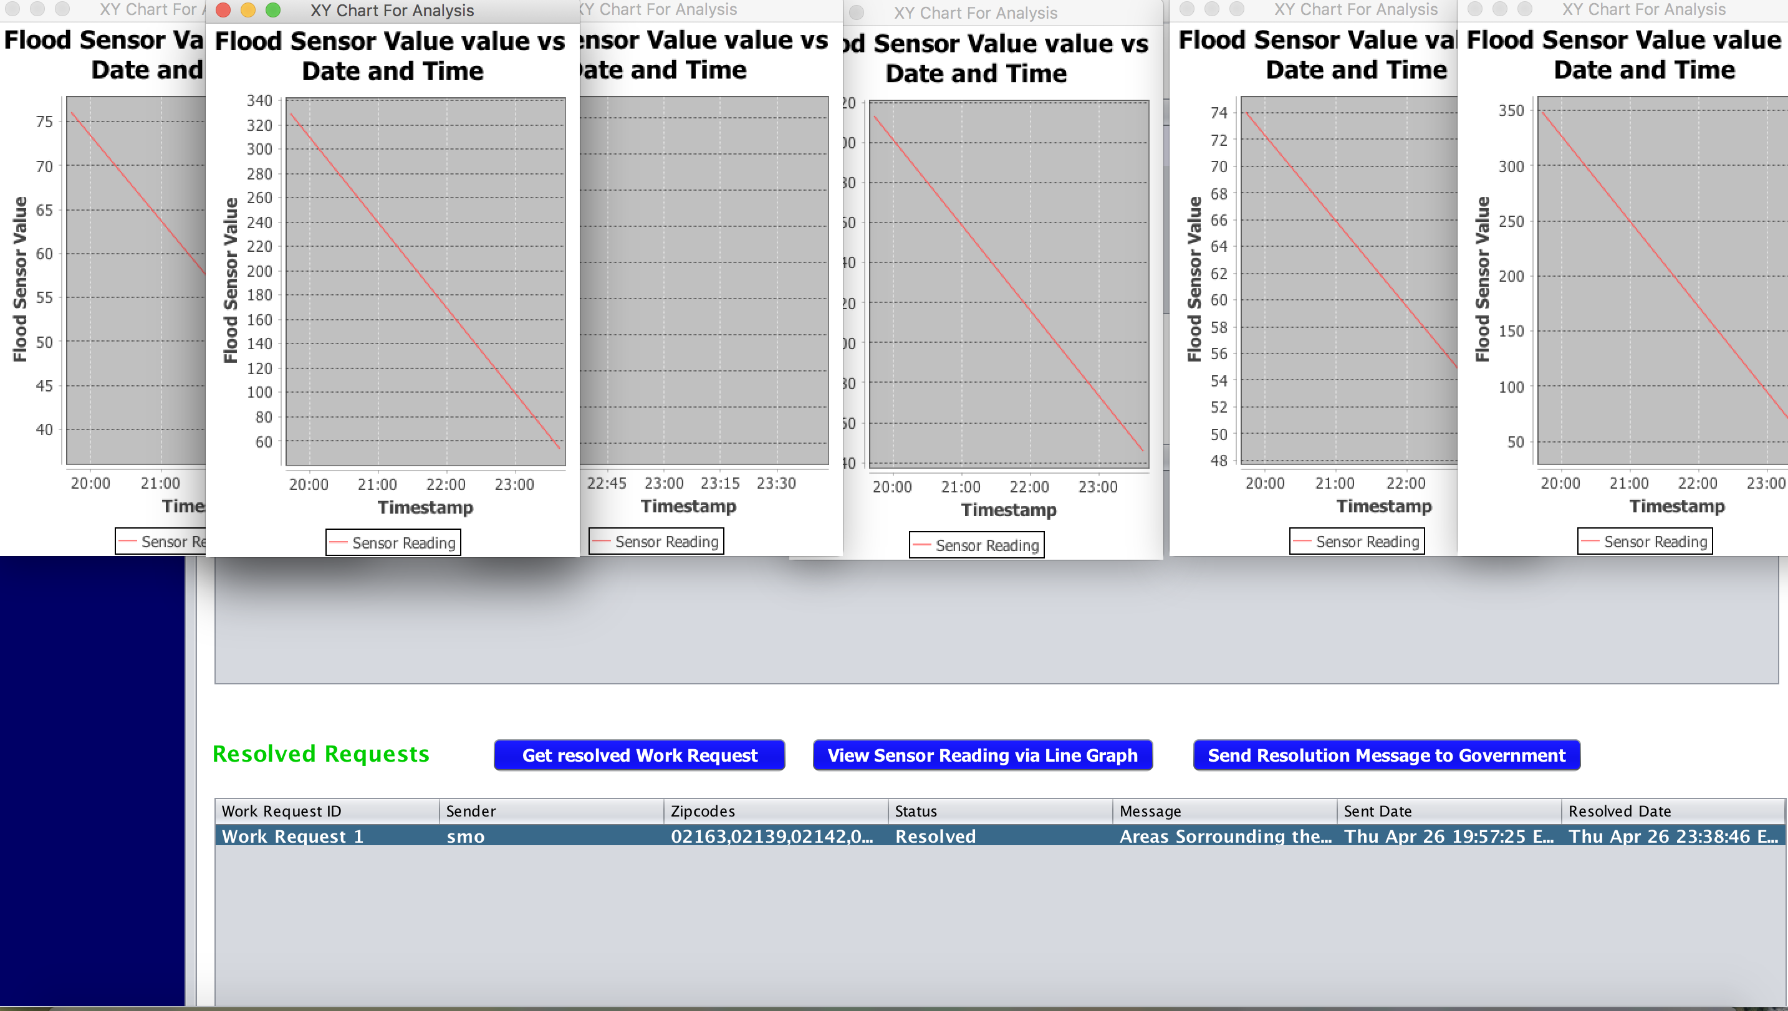
Flood Pollution Solution Department
This represent the Flood Pollution work queue of Sensor Management organization.
First table shows all the work requests created and resolved.
When we click on “Get Pending Work Request”,pending work request gets displayed in the “Pending Request” table.
Once the request is resolved, on clicking “Get resolved work request”,resolved request gets displayed in the “Resolved Request” table.
On clicking “View Sensor Reading”,we can see the reading of that particular sensor going below Threshold value by line graph.

Slide 21
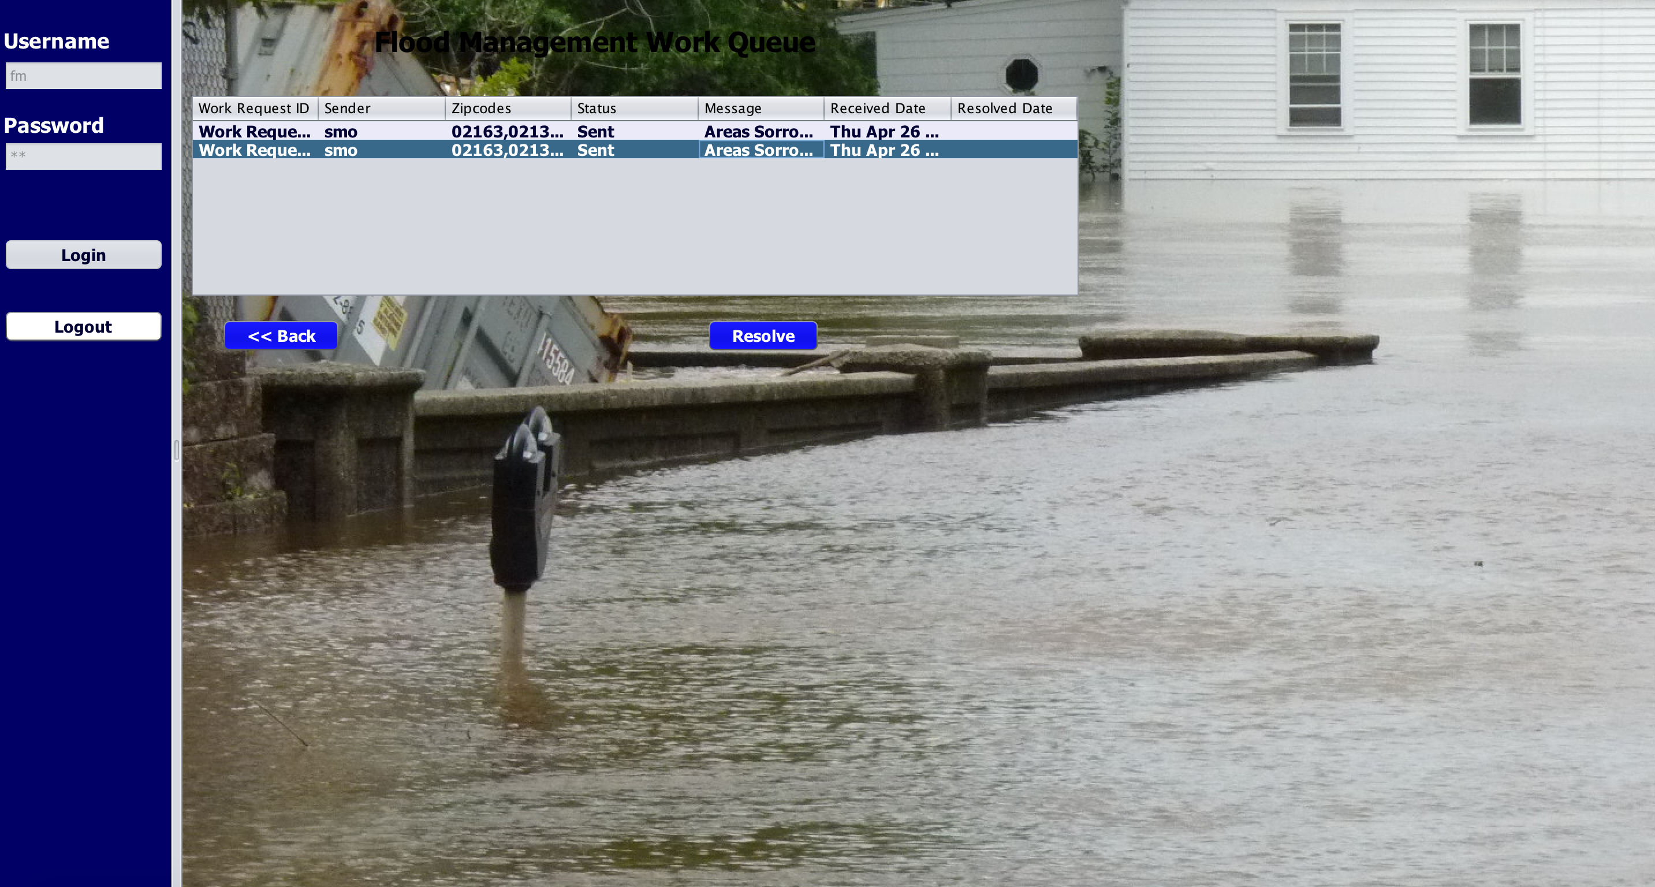
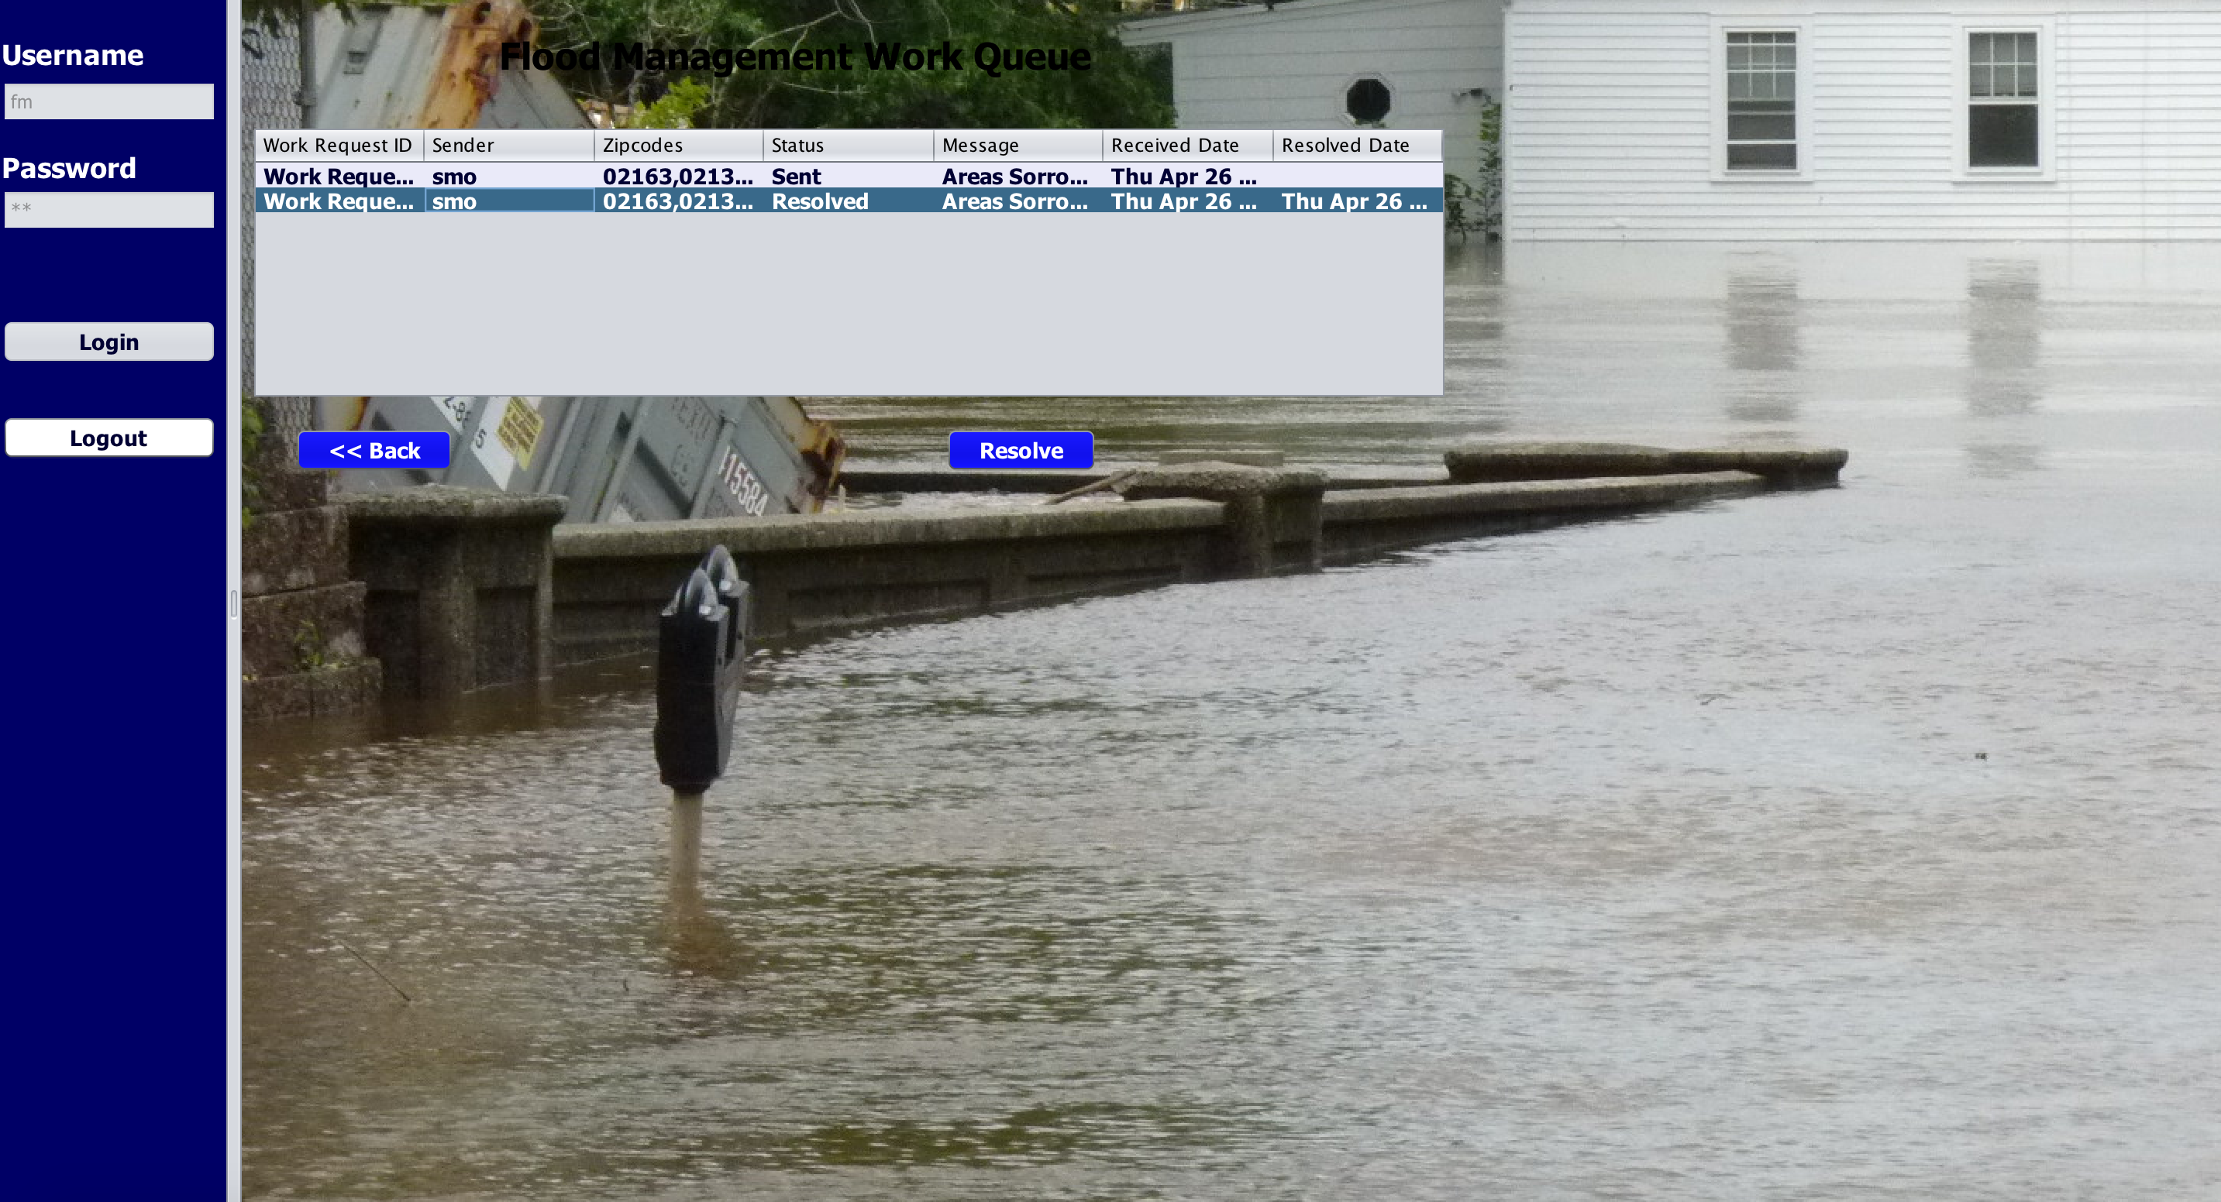
Flood Pollution Management Work Queue
This screen shows that the Status is set to “Sent”,when the request is received from Sensor Management Department.
When the Solution Department press “Resolve” button, then the Status will be changed to “Resolve”.

Slide 22
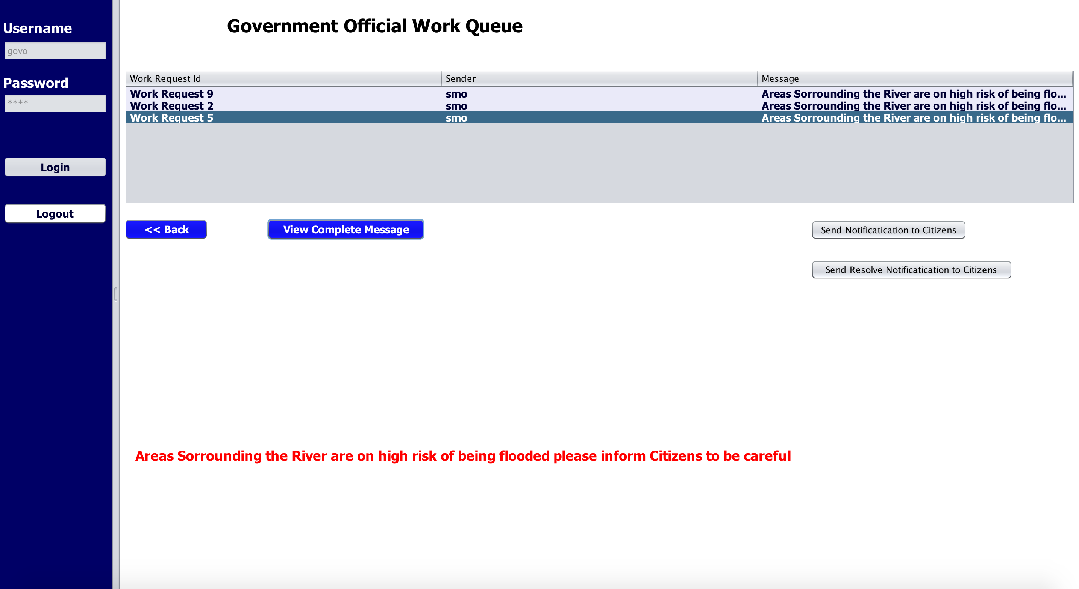
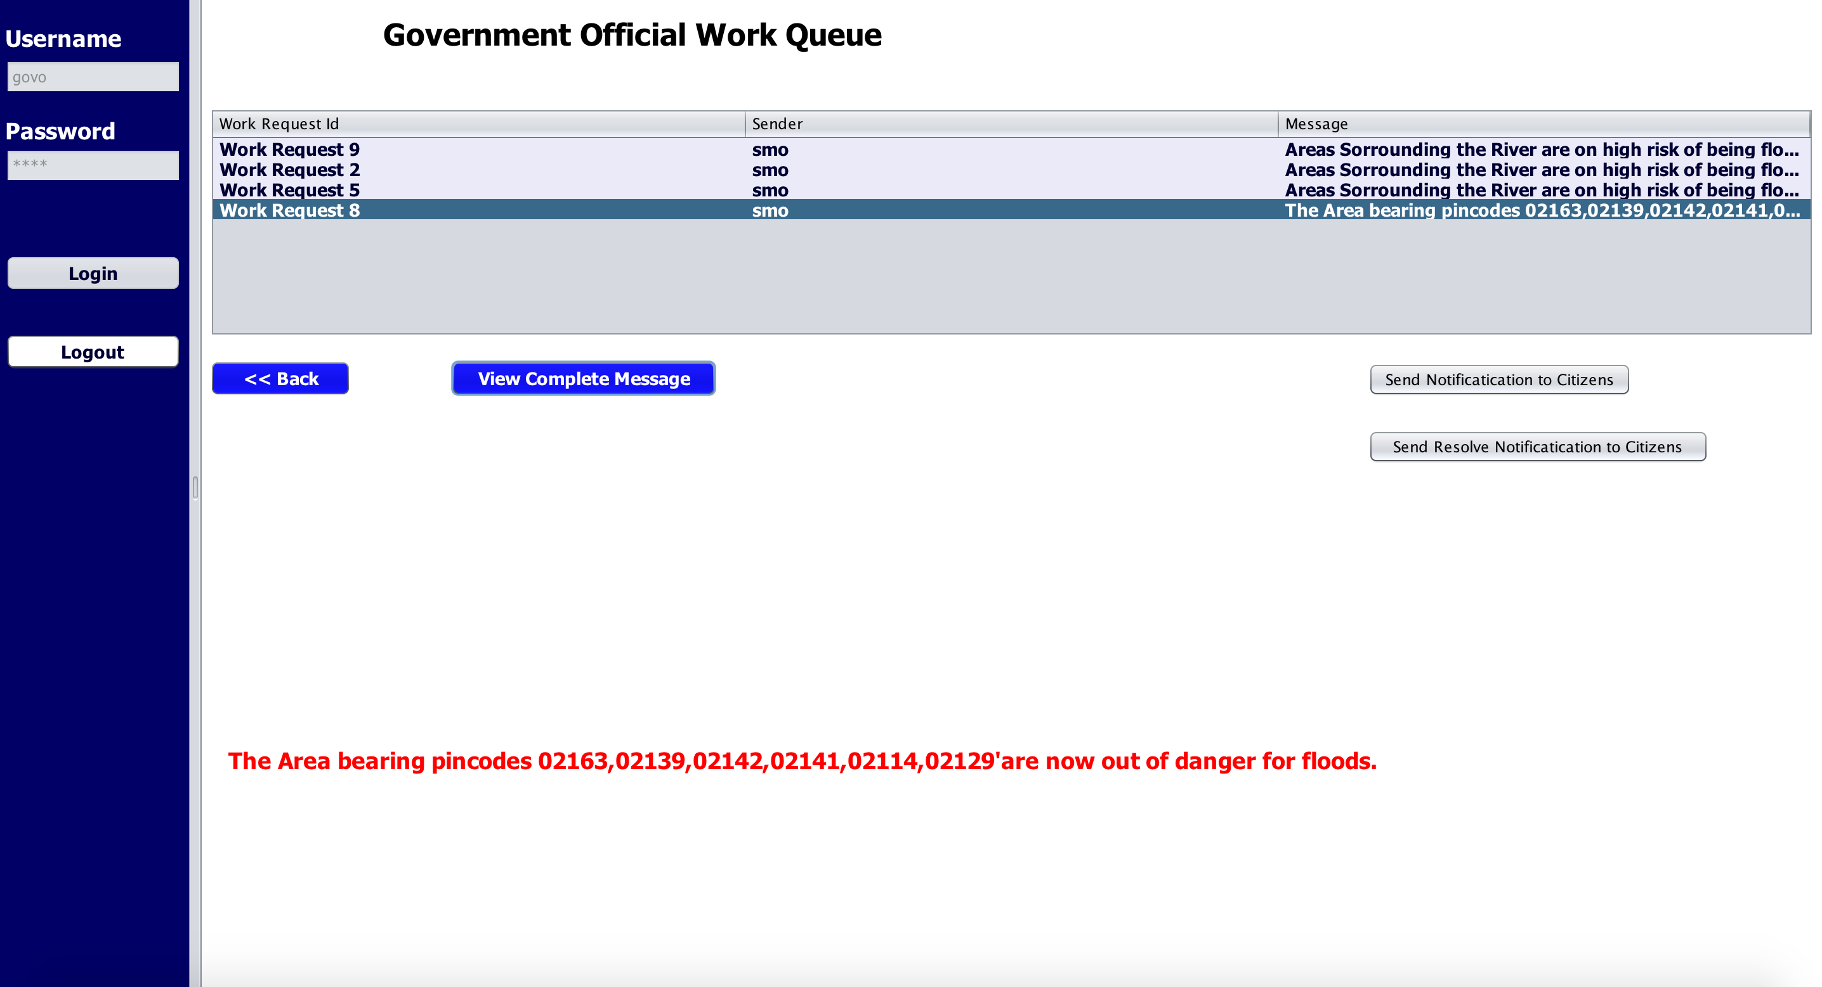
Government Work Queue
Sensor Management Organization will notify government about the high risk of being flooded to inform citizens.
Once the request is resolved, Sensor Management Organization will notify government so that they can tell the citizens.

Slide 23
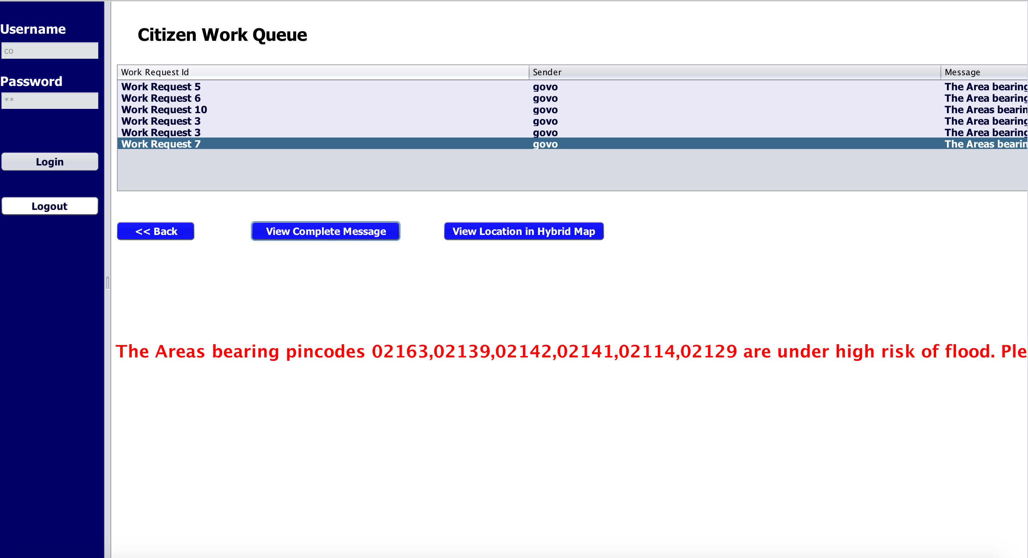
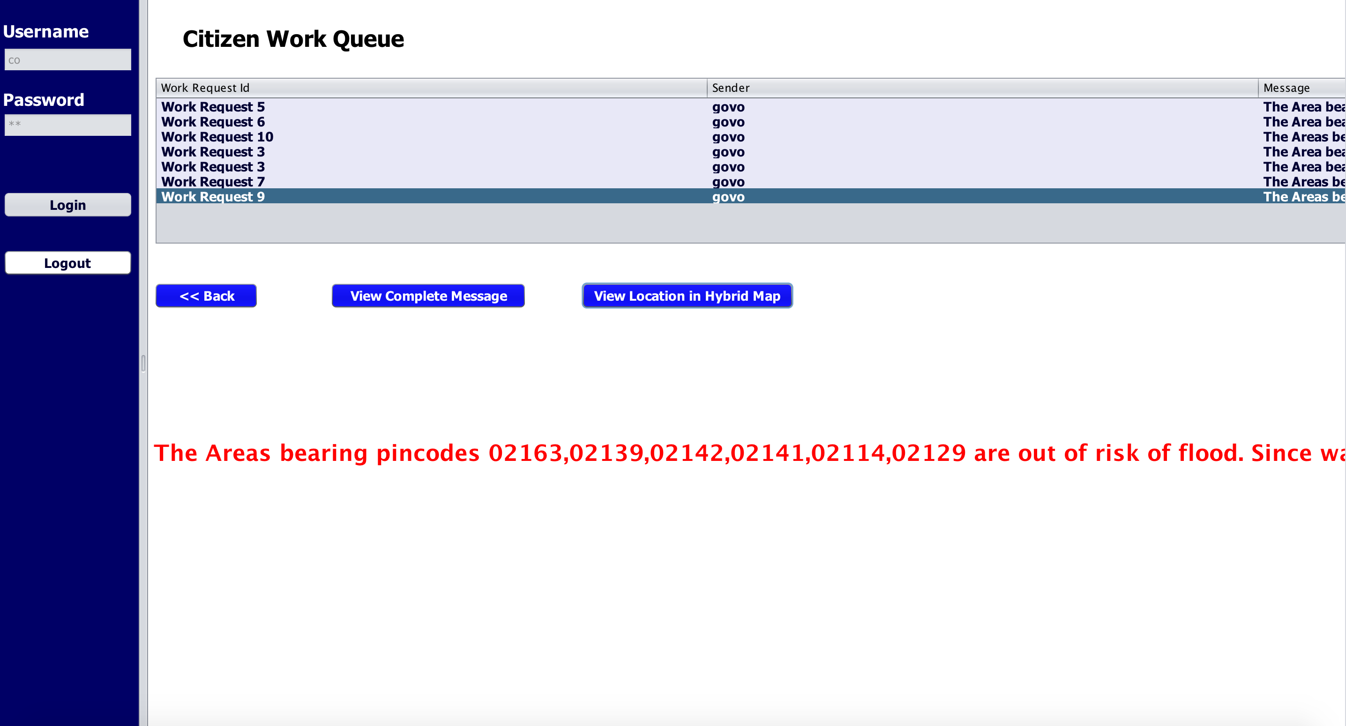
Citizen Work Queue
Government will notify citizens about high risk of flood.
Once the area is out of risk of flood, citizens will be notified by Government.

Slide 24
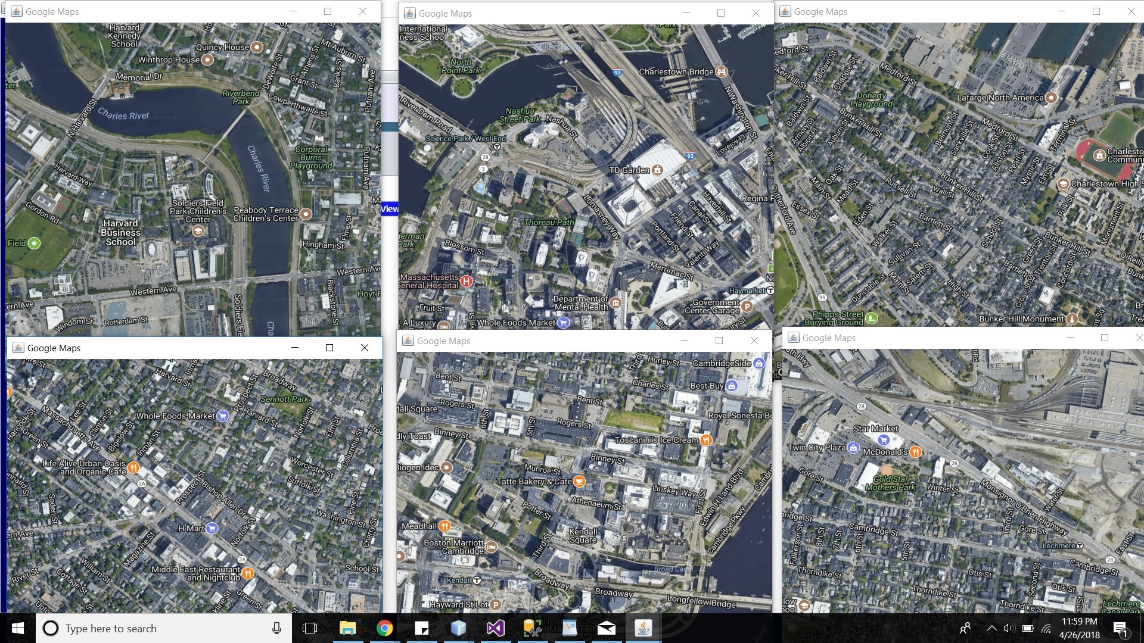
Flood Sensor Map View
Once we click on “view location in hybrid maps” in Citizen work queue , we get the real time location of all the areas around the riverbeds which are at risk of flood.

Slide 25
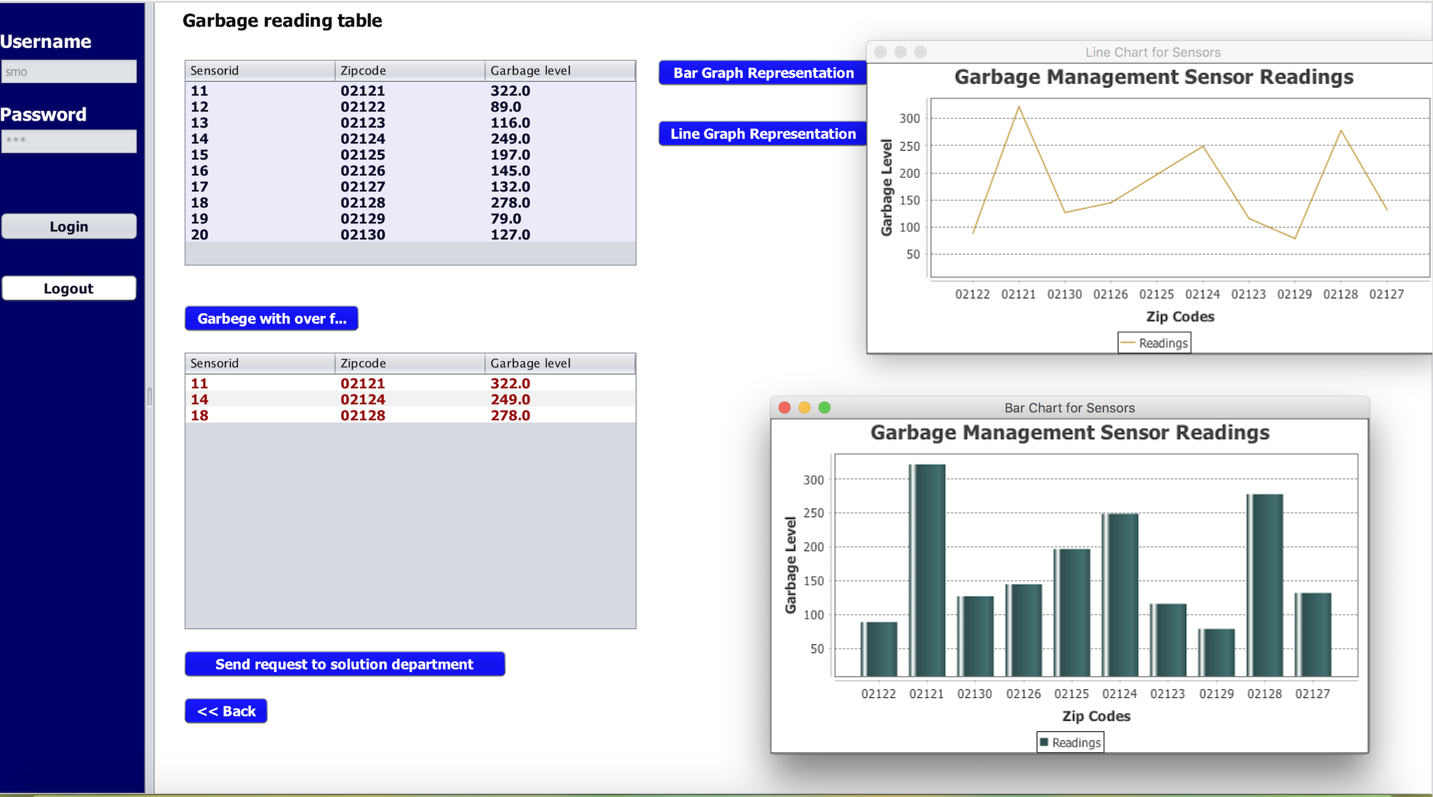
GARBAGE POLLUTION MANAGEMENT WORK AREA
The table below Garbage reading table gives the reading of all the sensors of various locations relevant to their zip codes.
The table below Garbage with overflow gives the readings of those zip codes which are above the threshold value.
Bar graph and line graph representation shows the Sensor readings of all areas with respect to their zip codes.

Slide 26
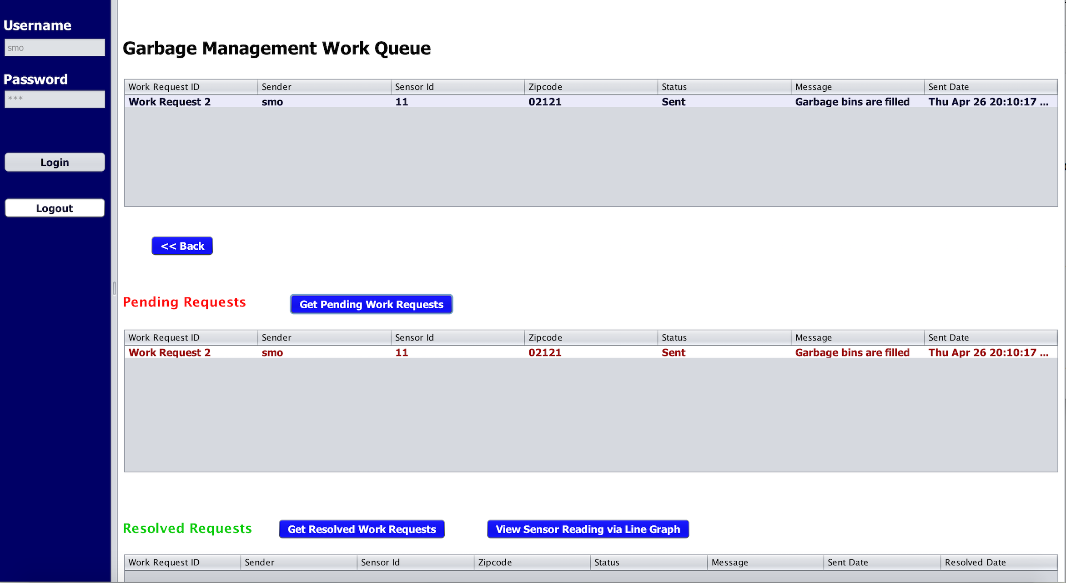
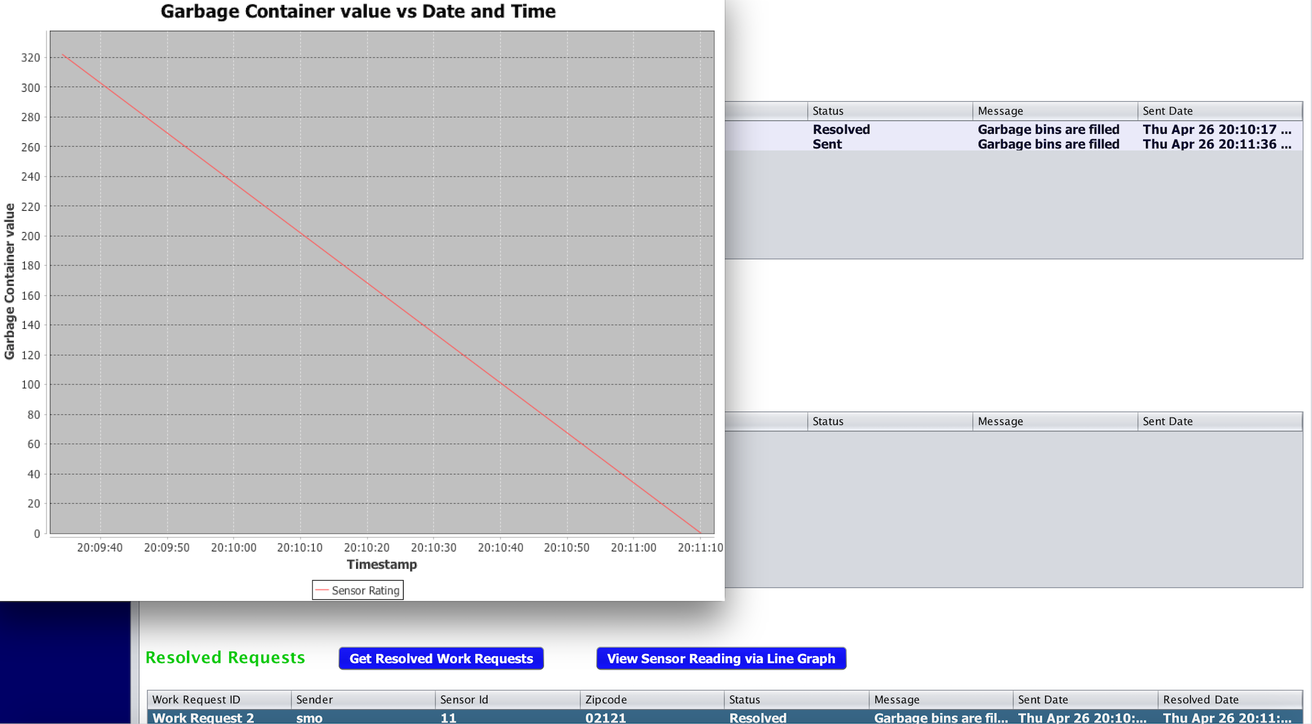
Garbage Pollution Solution Department
This represent the Garbage Pollution work queue of Sensor Management organization.
First table shows all the work requests created and resolved.
When we click on “Get Pending Work Request”,pending work request gets displayed in the “Pending Request” table.
Once the request is resolved, on clicking “Get resolved work request”,resolved request gets displayed in the “Resolved Request” table.
On clicking “View Sensor Reading”,we can see the reading of that particular sensor going below Threshold value by line graph.

Slide 27
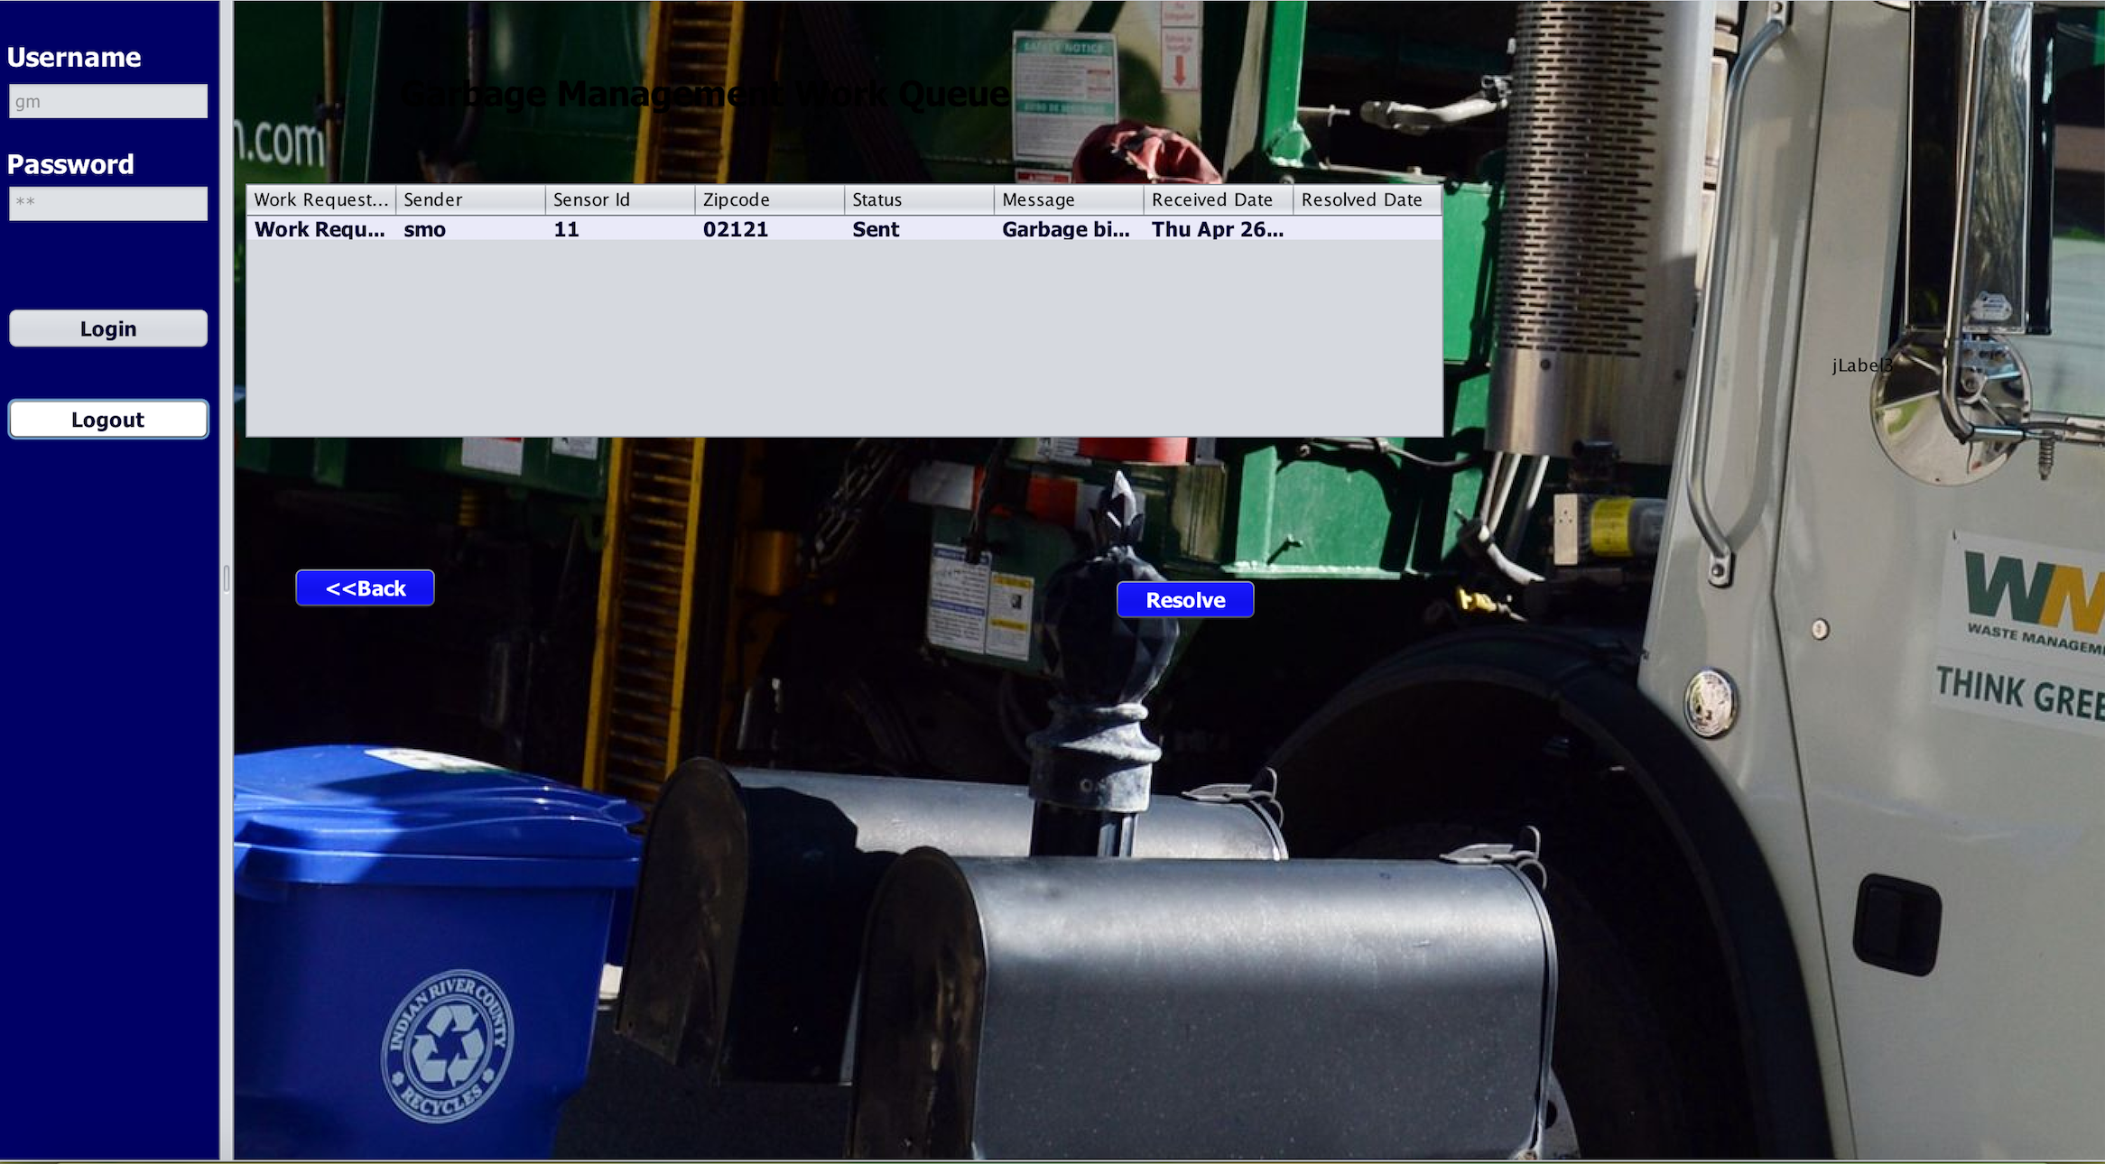
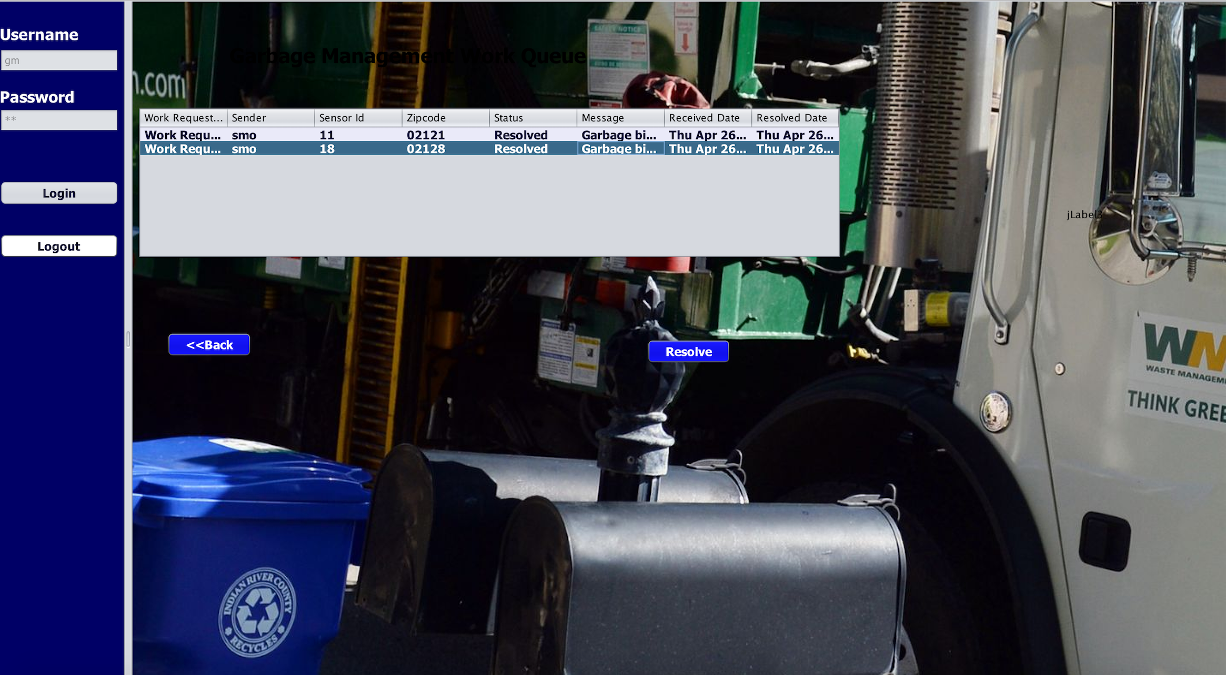
Garbage Pollution Management Work Queue
This screen shows that the Status is set to “Sent”,when the request is received from Sensor Management Department.
When the Solution Department press “Resolve” button, then the Status will be changed to “Resolve”.

Slide 28


